Slide 1
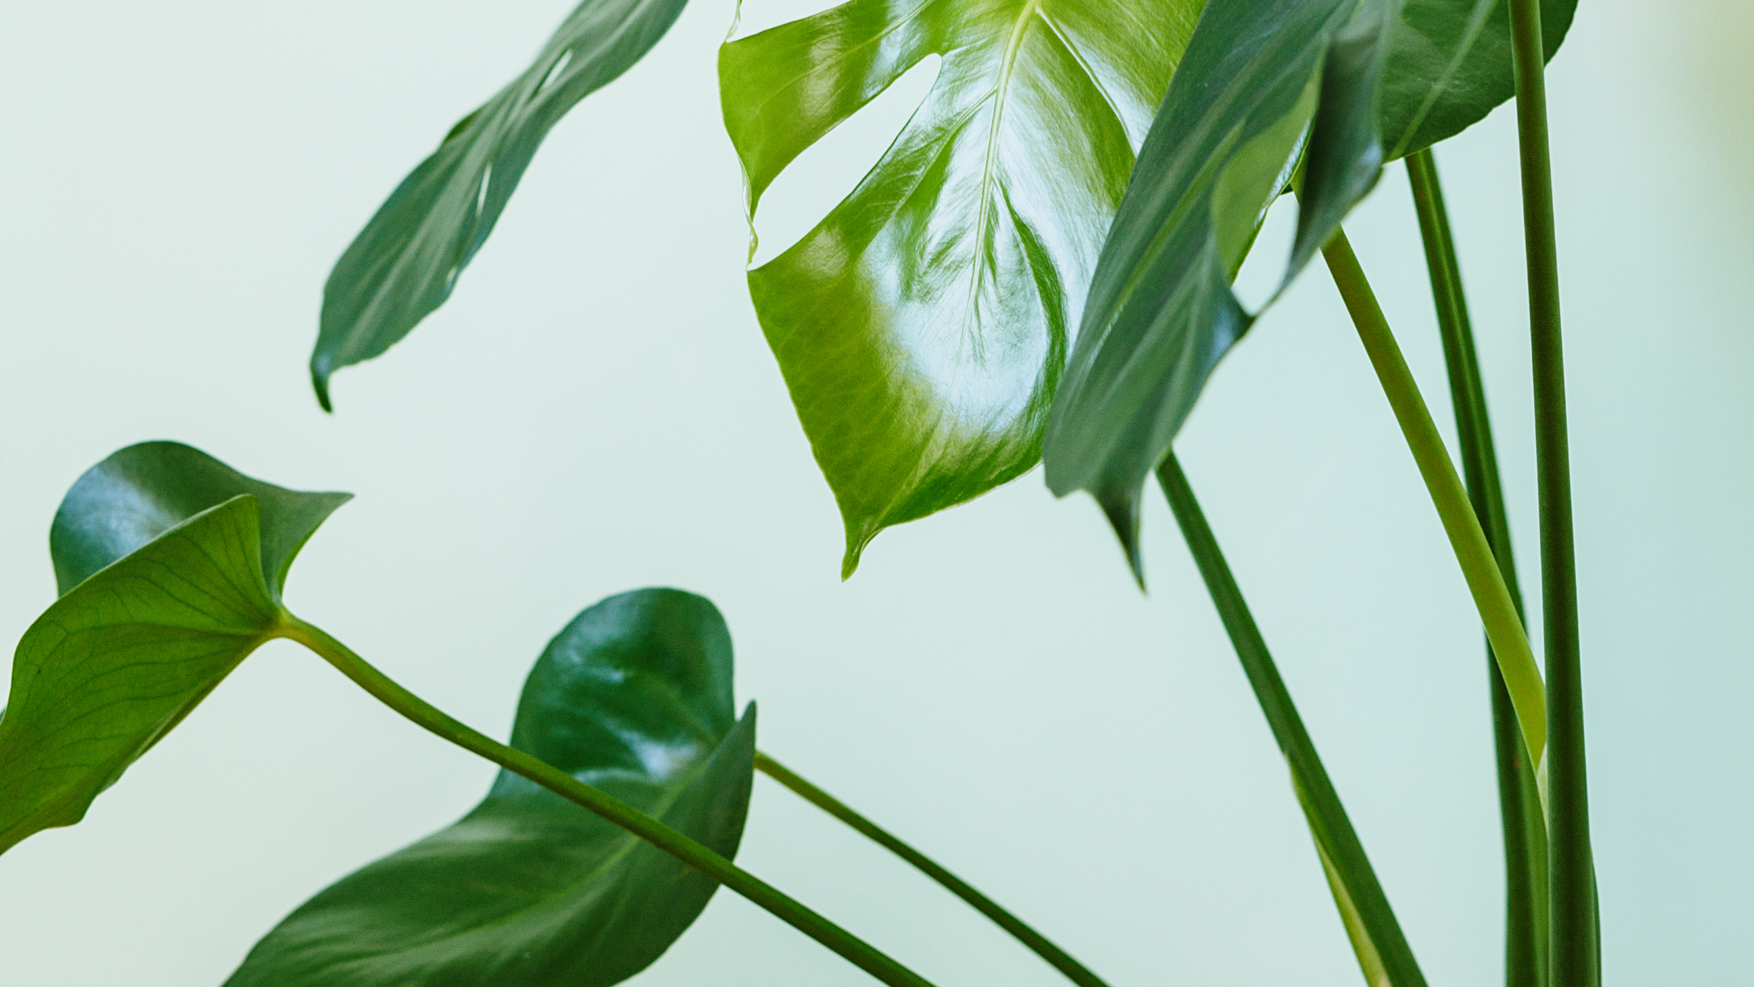
A Root Awakening
Plant propagation for beginners
Scottsdale Public Library – Civic Center

Slide 2
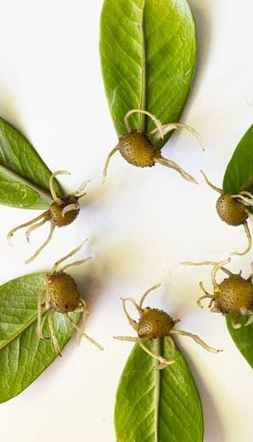
What You'll Learn Today
+ What plant propagation is
+ How to identify a plant node and take a cutting
+ What supplies you'll need to successfully propagate your cutting
+ How to identify a good root system and transfer your propagated cutting to soil
+ How to care for your plant once it's in soil

Slide 3
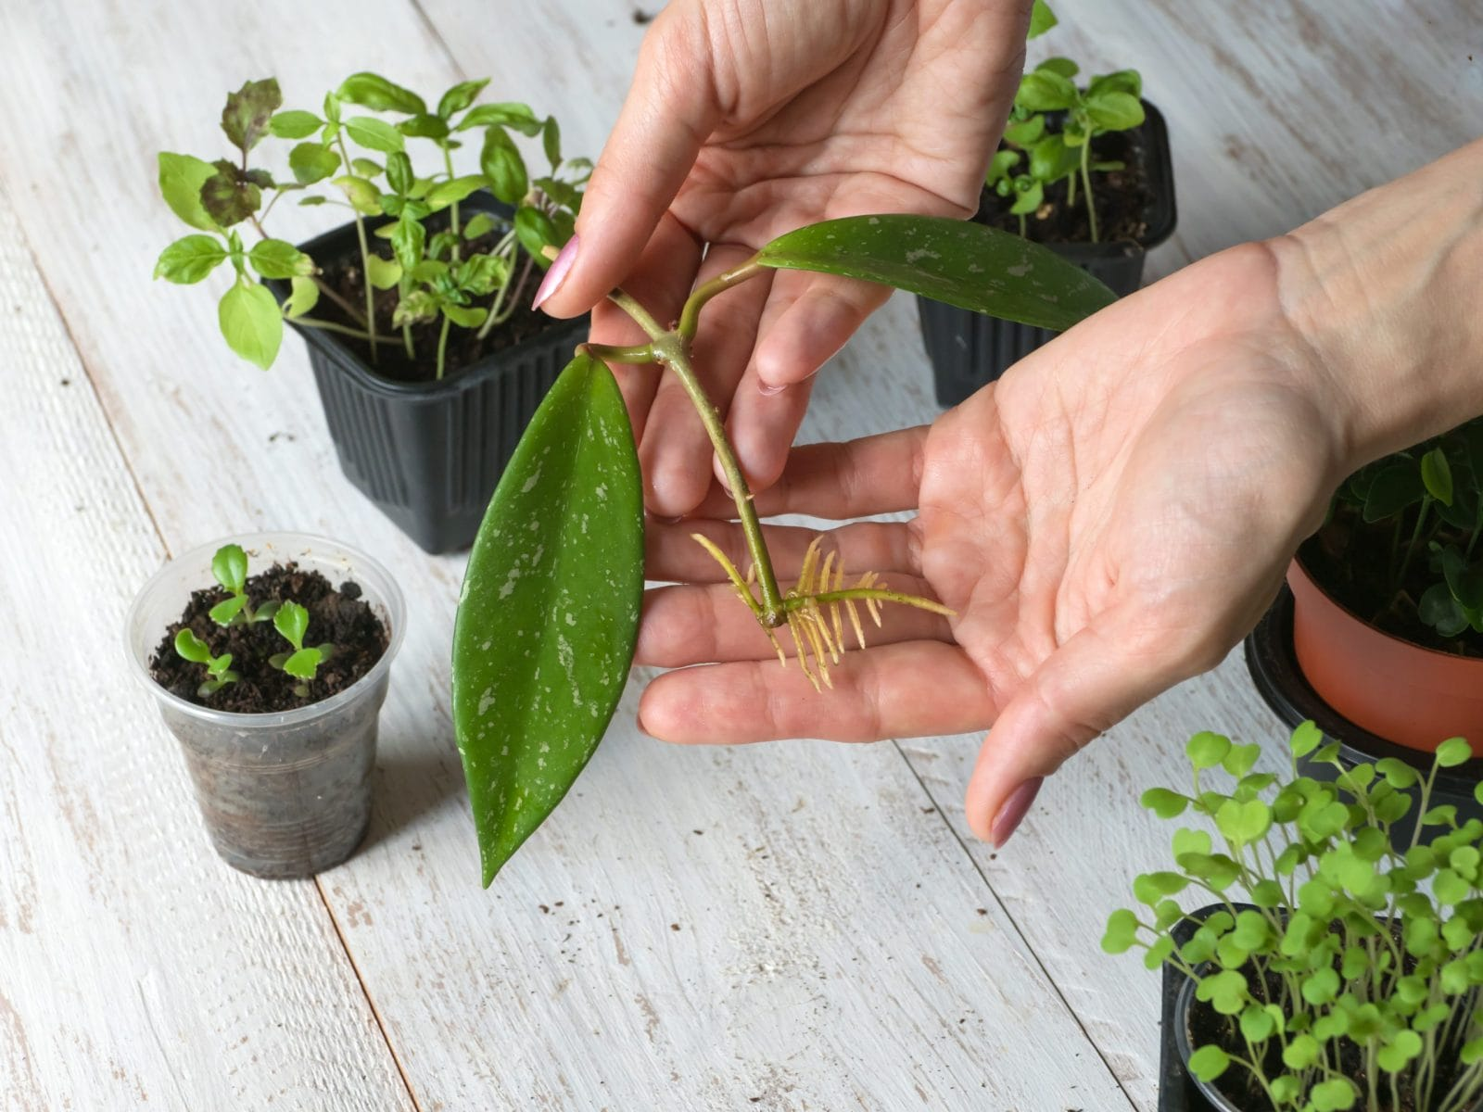
Intro to Plant Propagation
Plant propagation is the process of growing a new plant from seeds, cuttings, or specialized plant parts (ex: tulip bulbs). We will be propagating from plant cuttings today.
Methods of propagating plants from cuttings:
+ In water
+ In perlite (a type of moisture-retaining mineral used in plant care)
+ In sphagnum moss
Common houseplants that can be propagated using these methods:
+ Pothos + Philodendron + Monstera + ZZ Plant + Spider plants
+ Snake plants + String of Hearts + String of Pearls + Chinese money plant

Slide 4
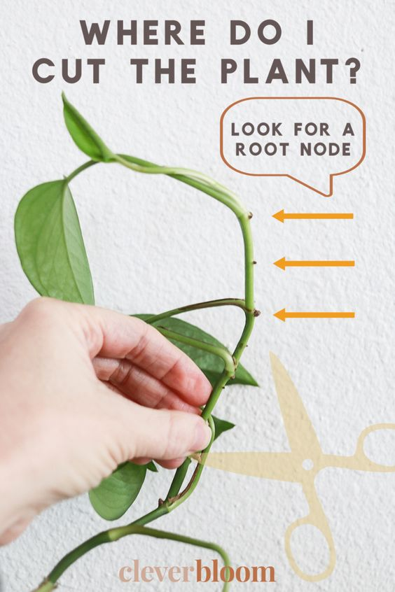
How to take a plant cutting
+ To successfully propagate your plant, your cutting must have at least one node
+ Nodes are the points on a plant stem where active cells develop roots or buds that grow into stems, leaves, or flowers depending on the plant.
+ Today we will be using a Pothos (epipremmum aureum) but all plants are different. Be sure to do your research, Youtube is a fantastic resource!
Why a pothos?
Pothos plants, also known as Devil's Ivy, are extremely hardy and resilient plants!
Notes:
Pause here and pass around pothos vines with nodes as example

Slide 5
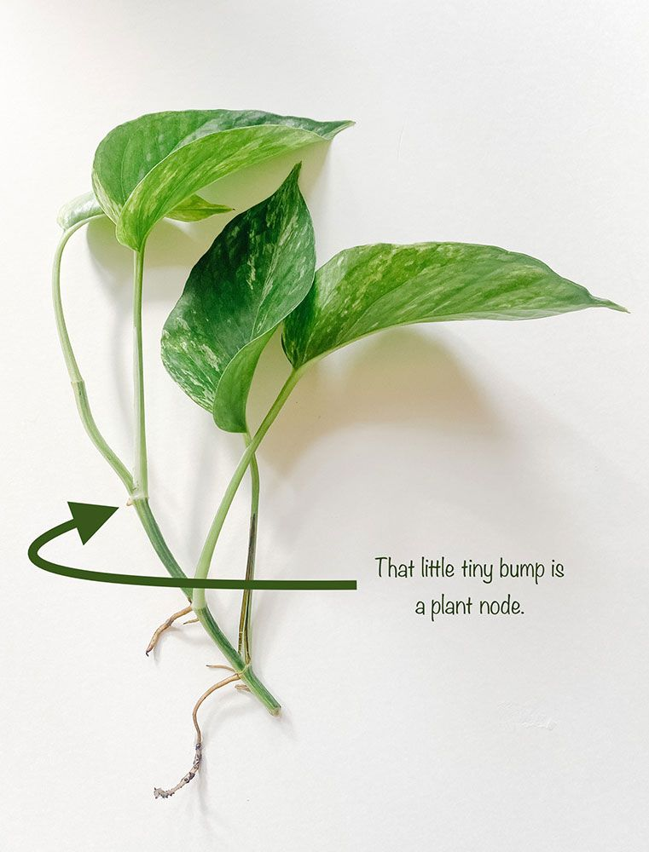
Supplies
+ Recycled clear plastic container with lid
+ Moistened sphagnum moss
  + Sphagnum moss is a type of light, moisture-retaining moss used in plant and animal care!
+ Plant shears
+ Spray bottle with water
+ Plant cutting with at least 1 node
+ Rooting hormone (optional)
  + Rooting hormone stimulates root growth and increases the chances for successfully establishing a root system

Slide 6
Making your Propagation Box
Take your cup and use a sharpie to write your name and today's date
Fill your cup halfway with moistened sphagnum moss, be sure to leave it loose and fluffy
With help from staff, use what you’ve learned to identify nodes on the Pothos plant and take 2 cuttings. Remove any leaves from your cuttings that are too large to fit in your prop box.
Dip the very ends of all cuttings in the rooting hormone and lightly shake off any excess
Place your cuttings in your prop box, return to your seat, and arrange the nodes of your cutting in the moss
Mist your cuttings lightly with water and cover with a small piece of seran wrap and then the lid. Done!
Notes:
Pause here and have patrons go through the process to create their prop box, resume presentation when all patrons have made their prop box

Slide 7
Caring for your Prop box
+ Your cuttings can take anywhere from 3 weeks to several months to establish a root system and be ready to plant. Don't give up! The use of rooting hormone should cut this time down.
+ Place your prop box in a warm spot in your house, out of direct sunlight but not totally in the shade either. Experiment and try different spots to see what works best.
+ Keep your prop box covered and check it once weekly. If it's too dry, spritz with water and consider adding a layer of Seran wrap over the top to keep in moisture. If you find your prop box stays too wet, try airing it out once a week to let some of that moisture escape.
+ Conditions inside your prop box should be moist/humid but not drenched. Over watering can lead to root rot and will kill your cutting.

Slide 8
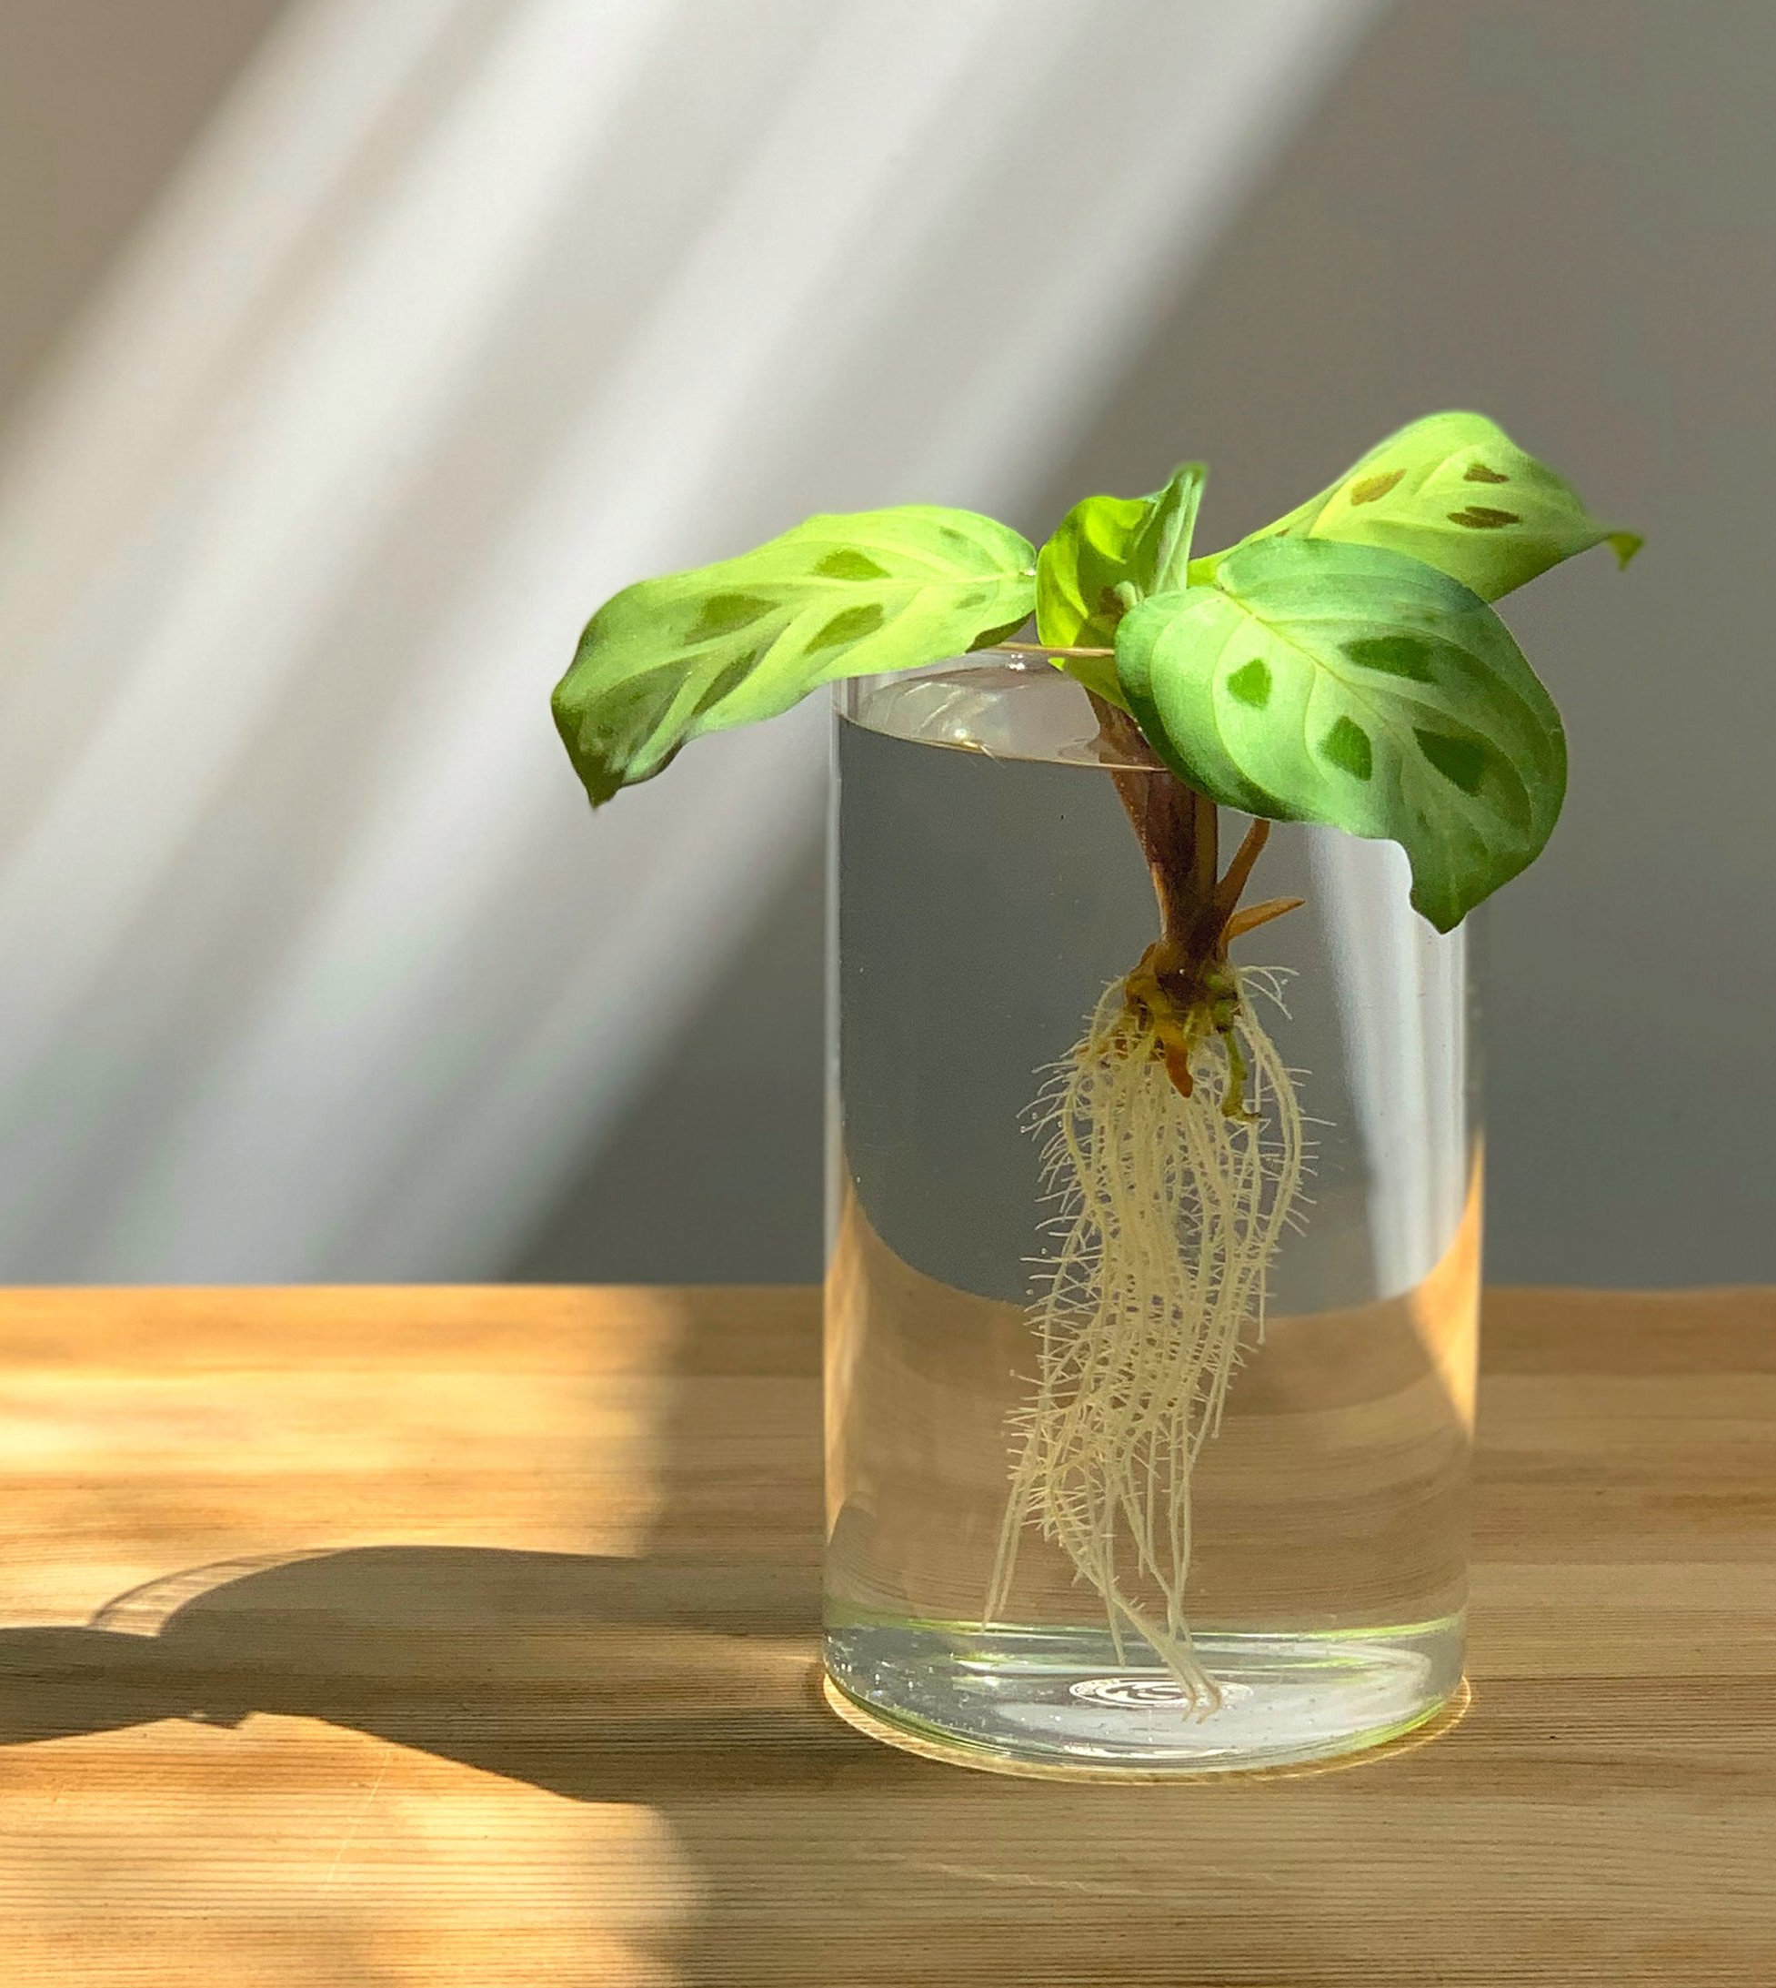
Transferring to Soil
+ Your cutting is ready to be transferred to soil when a good network of roots have been established.
What does a good root system look like?
  + Mini-network of white/light brown or green roots
  + Roughly 4-6 inches long
  If roots look black, mushy, or start to smell badly, they have begun to rot and are likely not suitable to be planted.
Notes:
Pause here and pass around rooted cuttings

Slide 9
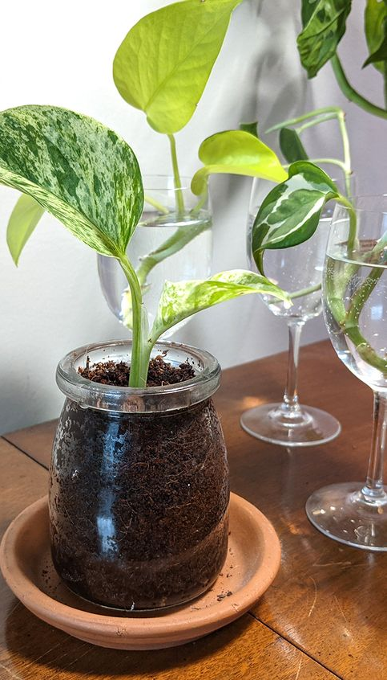
Transferring to soil
You will need:
  + A plant pot roughly 2-3 inches larger in diameter than the root system with a drainage hole
  + All purpose soil
  Gently remove as much sphagnum moss from the root system as possible without damaging them. (Have a good amount of sphagnum moss left? Try reusing it!)
  Once in soil, keep your potted pothos indoors in indirect sunlight. Water every 1-2 weeks or when you see the plant's leaves start to droop. Pothos are hardy plants that can bounce back so don't be afraid to persevere if your pothos gets a little neglected and starts to drop leaves.

Slide 10
Thank you!

