Slide 1
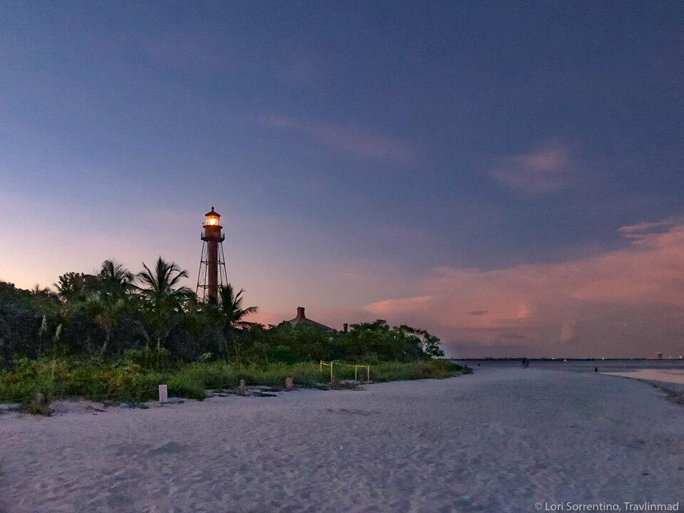
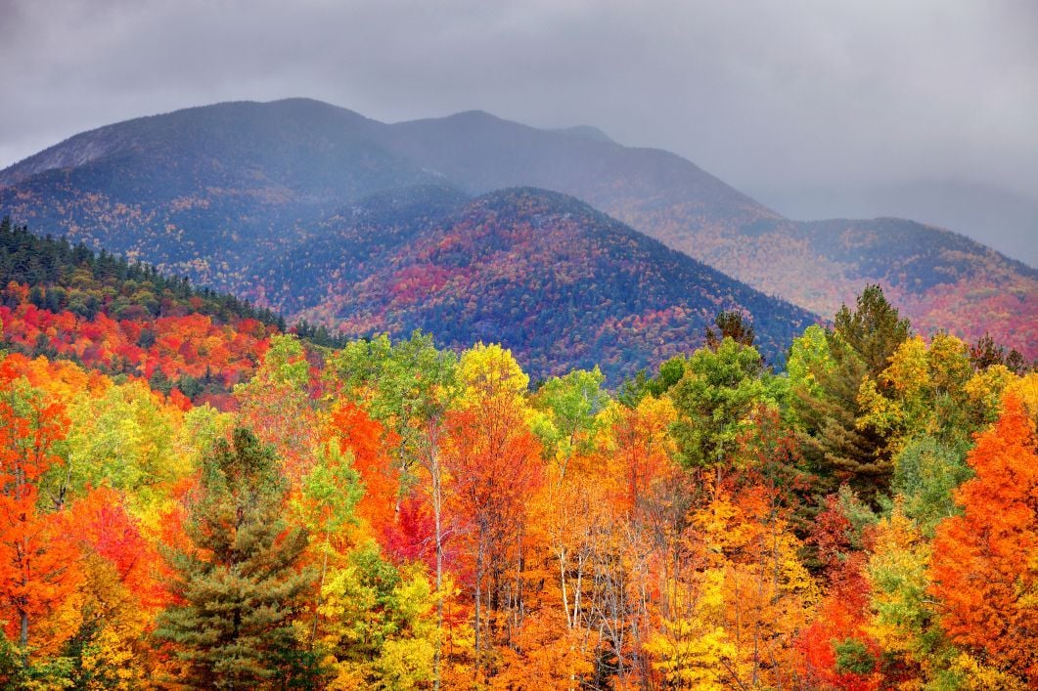
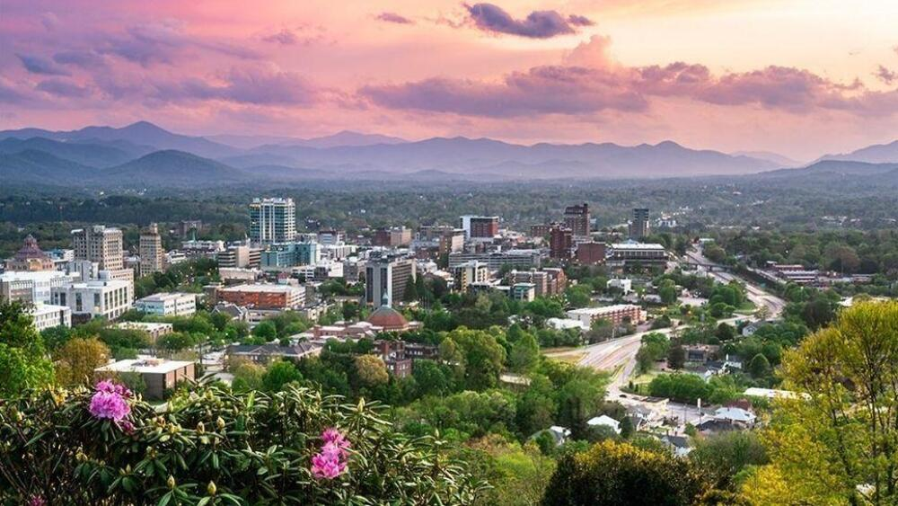
2025
Vacation
Pitch

Slide 2
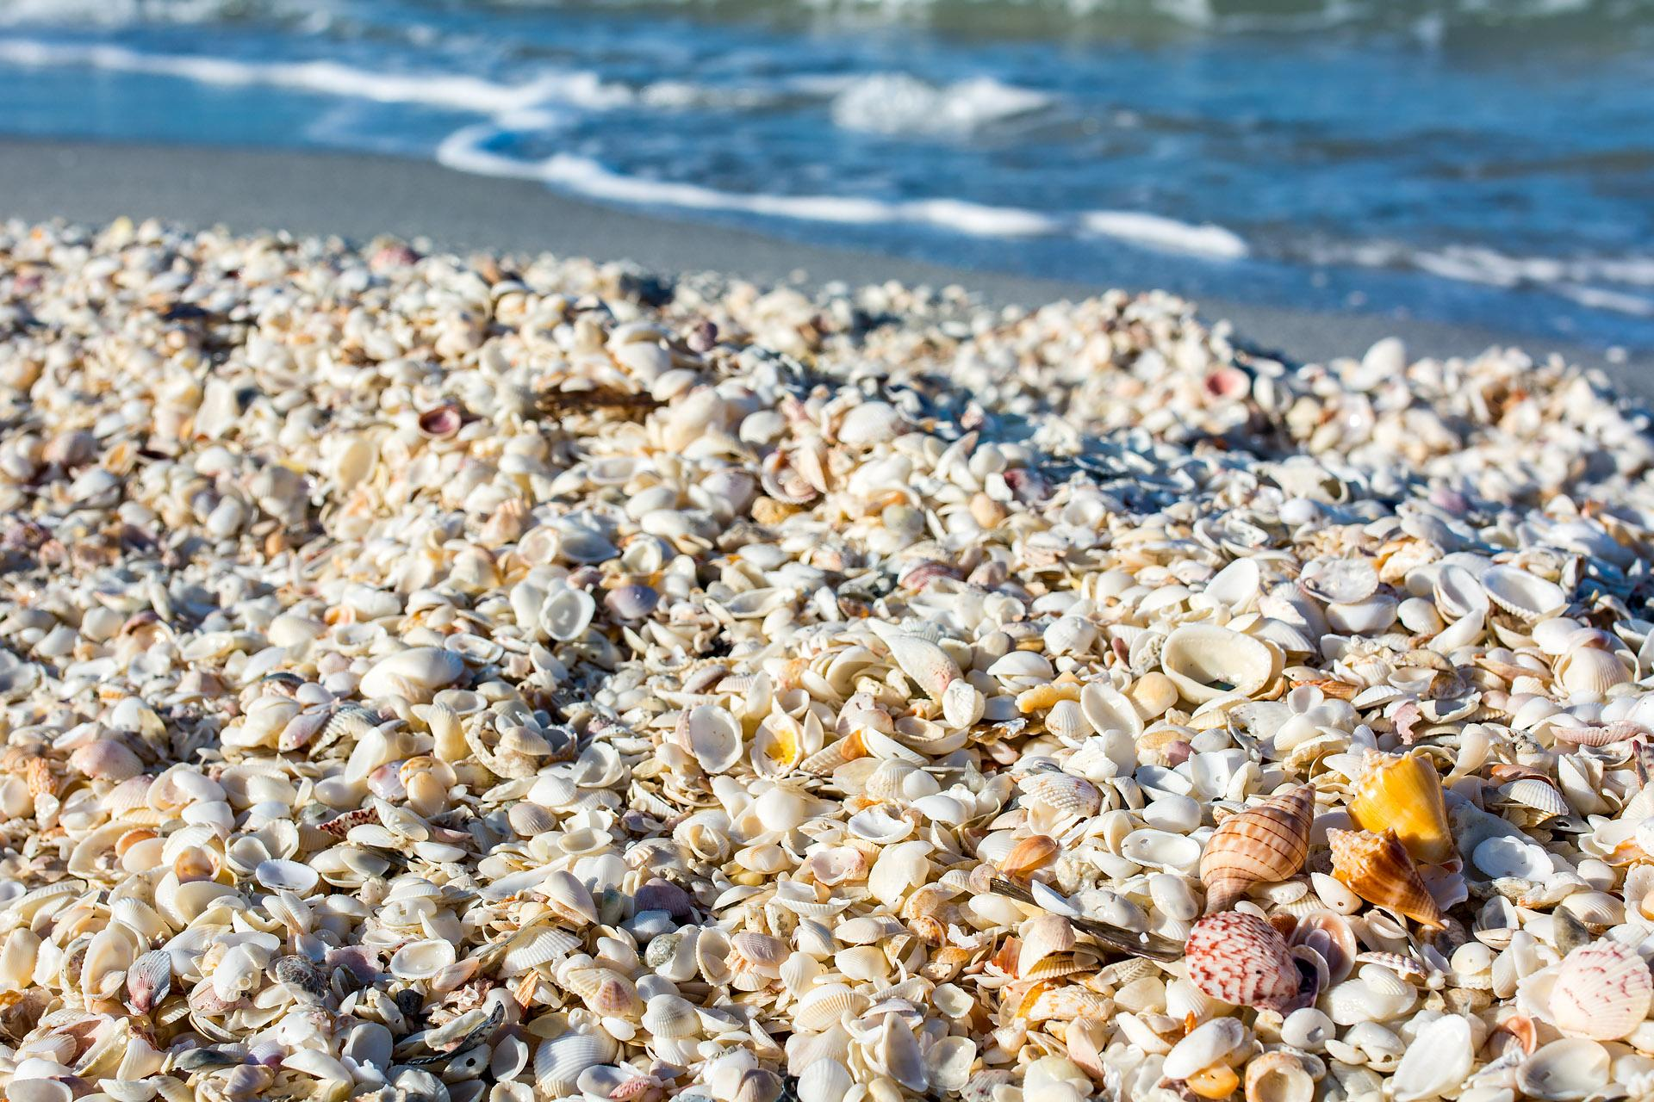
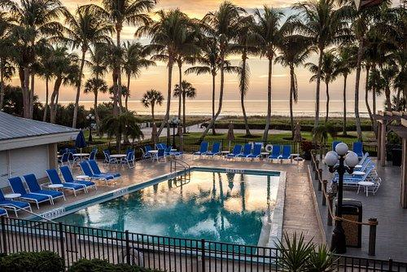
Sanibel Island
Florida
Can travel by car train or airplane!
Shells GALORE
Peaceful Shore
Calming Pools
Build a dock scene from a lobster trap
Paddle board or kayak tours (day or night!)
Painting by the dock

Slide 3
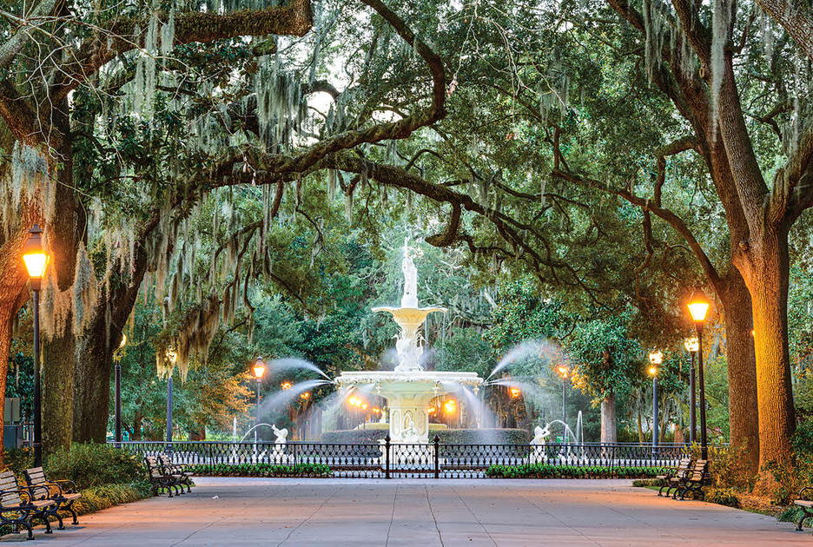

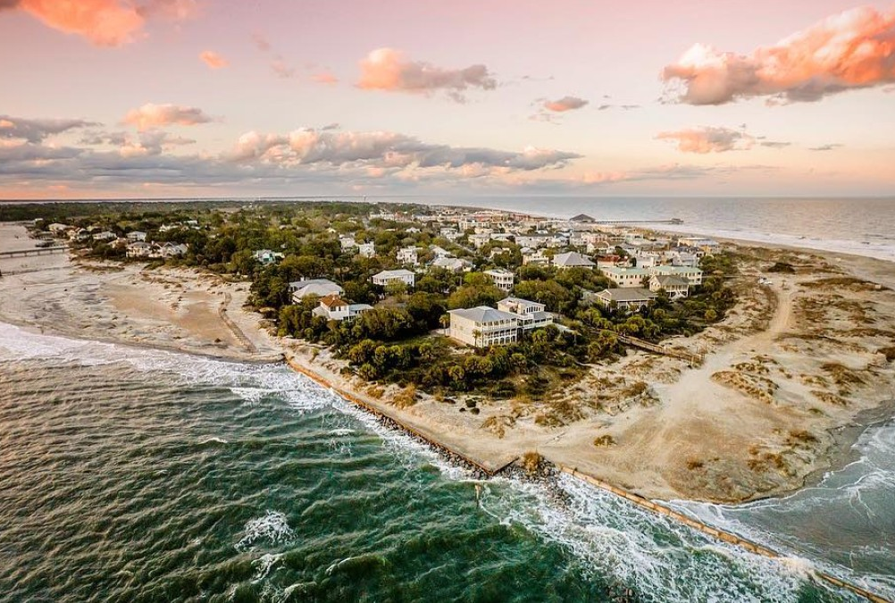
Savannah
Georgia
2 hour cheap flight or 12 hour car ride
Tours
Home of the Savannah Bananas
Tybee Island
Historical or haunted! Walking or biking.
Baseball or hockey!
Lighthouse, museum, fishing, kayaking, relaxing

Slide 4
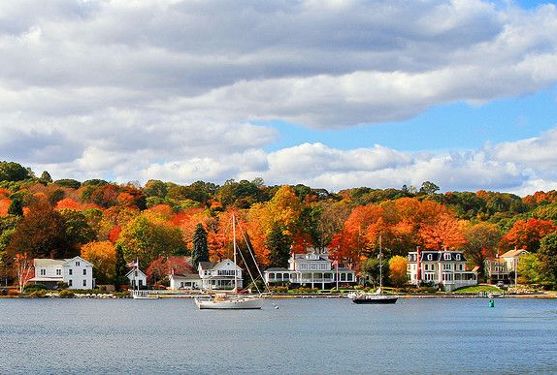
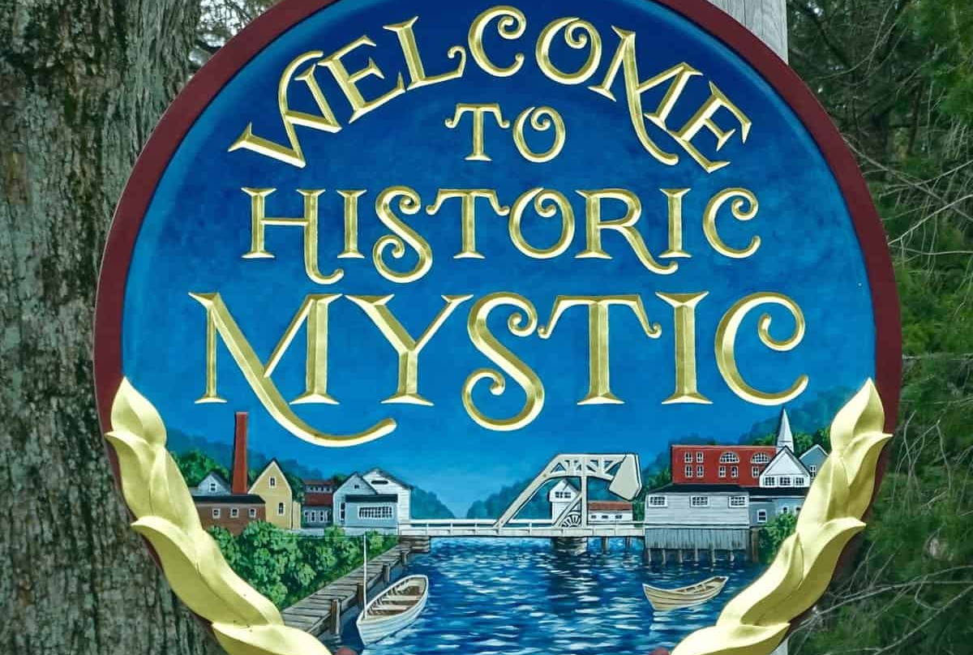
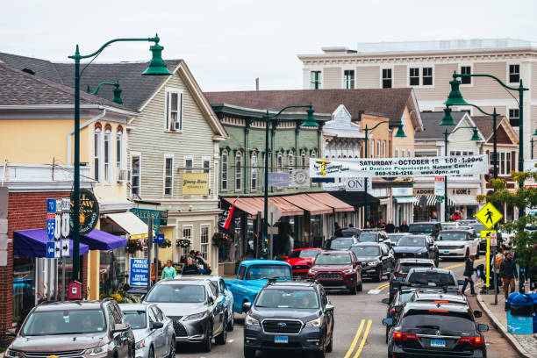
Mystic
Connecticut
3.5 hour drive
Aquarium
Wild Mushroom Festival
Quaint Downtown
Paint with a seal!
Fun weekend festivals
Shopping, tours, water sports

Slide 5
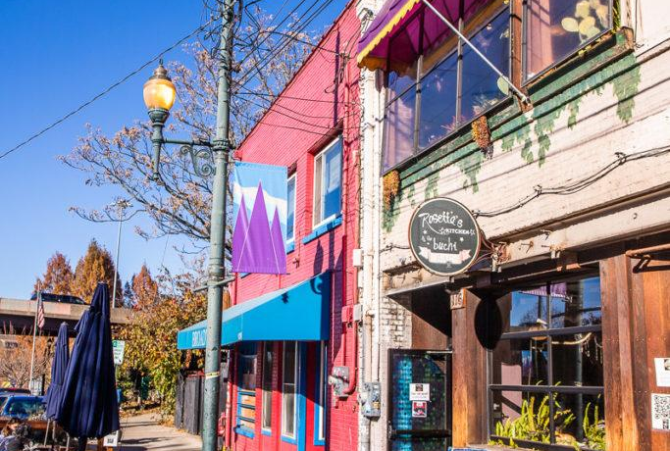

Asheville
North Carolina
9 hour drive or cheap flight
Art Workshops
Biltmore
Blue Ridge Mountains
Forging, glass, and even stilt-walking!
History and architecture
Hiking, Ziplining, & Waterfalls
Visit Little Switzerland on the foothills

Slide 6
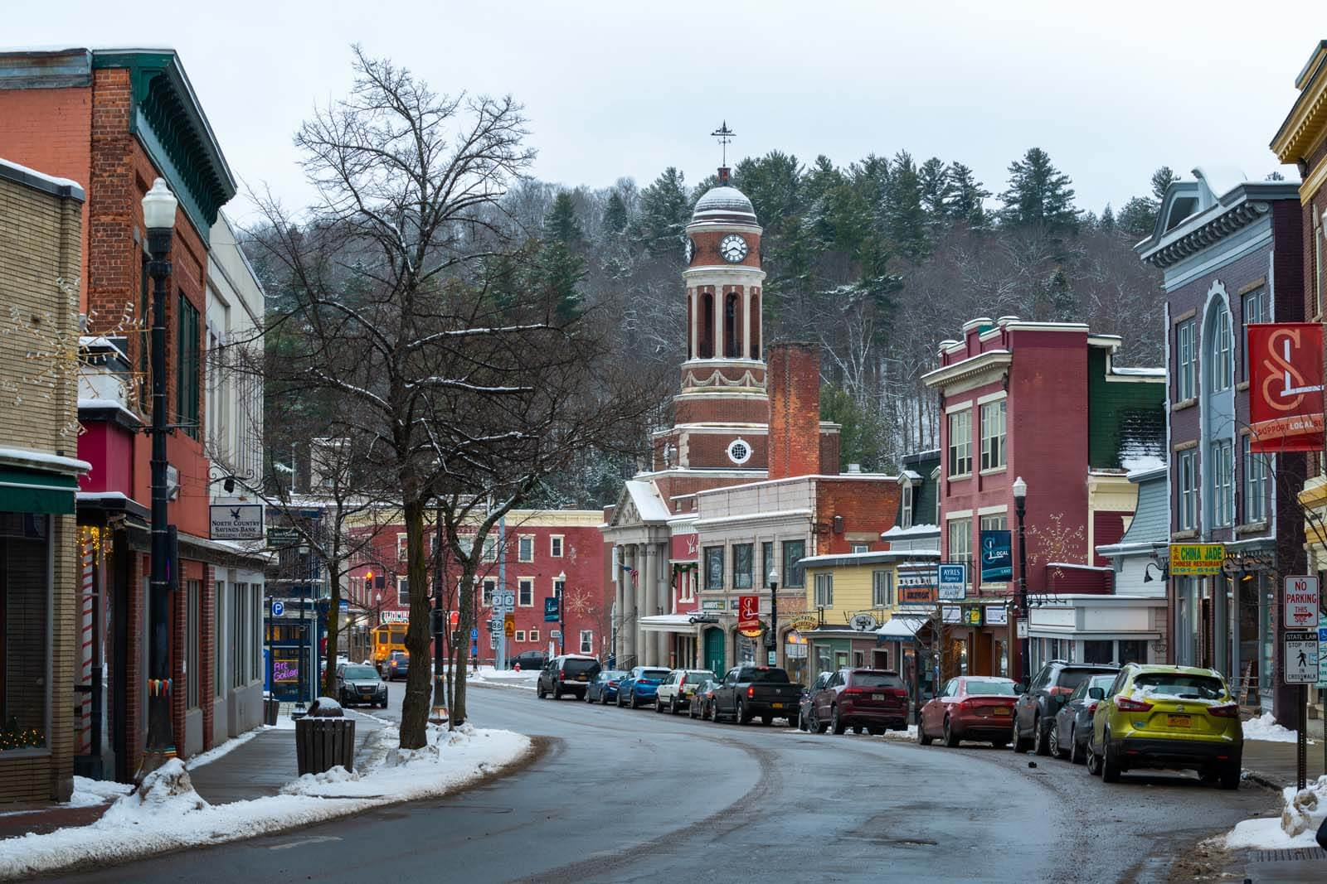
Adirondacks
New York
9 hour drive or cheap flight
Fun Stuff
Adirondack Living
Lakes
Maple Sugaring, Adirondack Folk School, Adirondack Experience Basket Making
Hiking, boat tours, historic tours, war tours
Lake Champlain, Lake George, Lake Placid, and more!

