Slide 1
Hands-On History: Bringing History Alive with Historical Artifacts
Stone Bridge High School
November 4, 2025
Notes:
Good afternoon and welcome, everyone! My name is Em Gallaugher and I am a program officer in the Public Programs Office at the American Library Association. I’m pleased to introduce today’s webinar, Hands-On History: Bringing History Alive with Historical Artifacts. Next Slide Please.

Slide 2
Welcome and Announcements
Today’s webinar is a presentation of ALA’s Public Programs Office, with support from ALA’s Cultural Communities Fund (www.ala.org/CCF) in cooperation with the American Association of School Librarians (www.ala.org/aasl).
Visit www.programminglibrarian.org for more online learning sessions, programs ideas, and grant announcements.
Notes:
Today’s webinar is a presentation of ALA’s Public Programs Office, with support from ALA’s Cultural Communities Fund (www.ala.org/CCF) in cooperation with the American Association of School Librarians (www.ala.org/aasl).
Hopefully, many of you are familiar with Programming Librarian, a website of ALA’s Public Programs Office. We have a lot of program ideas and an online learning library full of free webinars like this one on the website, as well as announcements of grants and other opportunities. The Sara Jaffarian School Library Program Award for Exemplary Humanities Programming recognizes excellence in humanities programming in libraries that serve children in grades K-12. This $5,000 award open to U.S. school libraries, public or private, that serve children in any combination of grades K-12 are eligible, provided the library is staffed by a state-certified librarian. Libraries are encouraged to self-nominate. Nominated humanities programs took place during the current 2024-2025 school year.
You can learn more about the award by going to ala.org/jaffarian. Next slide please.

Slide 3



About the Classroom
Microphones
Only our presenter has microphone access during the presentation. Live captions can be enabled by clicking on “Show Captions”.
Questions?
Use the Q&A to ask
questions of the presenters or ALA staff, including technical questions.)
Chat
Use the CHAT to talk with other attendees.
Notes:
Tech Slide – Em
A couple of notes about our virtual classroom. Only the presenter has microphone access. Live captions can be enabled by clicking on “Show Captions”.
Please use the Q&A function to ask questions of the presenters or ALA staff, including any technical questions.
You can use the chat for general comments and discussion with other attendees.
Now I will turn things over to former Jaffarian Award Committee Chair, Anne Link, to share some remarks. Next Slide Please

Slide 4

Anne Link
Former Chair of the Sara Jaffarian Award Committee
Notes:
INTRODUCTION OF AWARD FROM JAFFARIAN COMMITTEE CHAIR
The Sara Jaffarian School Library Program Award for Exemplary Humanities Programming recognizes excellence in humanities programming in libraries that serve children in grades K-12. This $5,000 award open to U.S. school libraries, public or private, that serve children in any combination of grades K-12 are eligible, provided the library is staffed by a state-certified librarian. Libraries are encouraged to self-nominate. Nominated humanities programs took place during the current 2024-2025 school year.
You can learn more about the award by going to ala.org/jaffarian

Slide 5
Today’s Presenters
Laura Channing, Librarian
Stone Bridge High School
Ashburn, VA
Laura Channing has her B.A in History from the University of Richmond and her Master of Library Science from St. John’s University. As an undergraduate student, she worked in museums before pursuing a career in Education. The Historical Artifact Footlocker program is the perfect blend of hands on history and education, combining her two passions.
Erin Curry, Librarian
Stone Bridge High School
Ashburn, VA
With a Bachelors in History; Master’s in History; Master’s in Curriculum and Instruction, Secondary Social Studies Education; and Master’s in Library Science, Erin was a classroom social studies teacher for seven years before making the switch to the library six years ago. Here, her passion for history, research, teaching, and books naturally led to the creation of the Historical Artifact Footlocker program. Erin brings a blend of academic and hands-on experience to help students connect with the past in meaningful, engaging ways.

Slide 6
Hands-On History: Bringing History Alive with Historical Artifacts
ALA’s 2025 Sara Jaffarian School Library Program Award Winner

Slide 7
Learning Outcomes
Design and curate your own artifact footlockers from different time periods that align with your social studies curricula
Identify strategies for selecting, obtaining, and presenting artifacts to support historical inquiry and historical thinking skills
Develop lesson plans to transform library spaces into interactive learning environments that promote curiosity and deeper understanding of history

Slide 8
About Our School/Library
9-12 public high school
Suburban, Northern Virginia
Student population: around 1,600
Flexible library schedule
Block scheduling (90ish minutes/block)
2024-2025 School Year
5,673 circs
428 classes booked, by all 8 departments
Over 12,000 passes made to the library

Slide 9
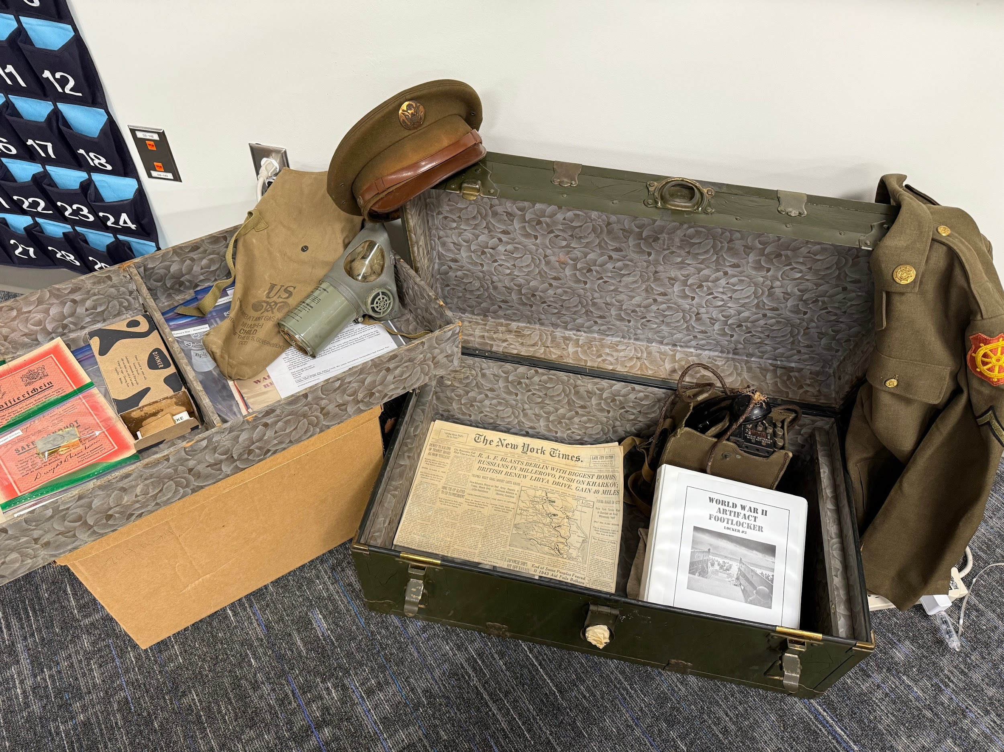
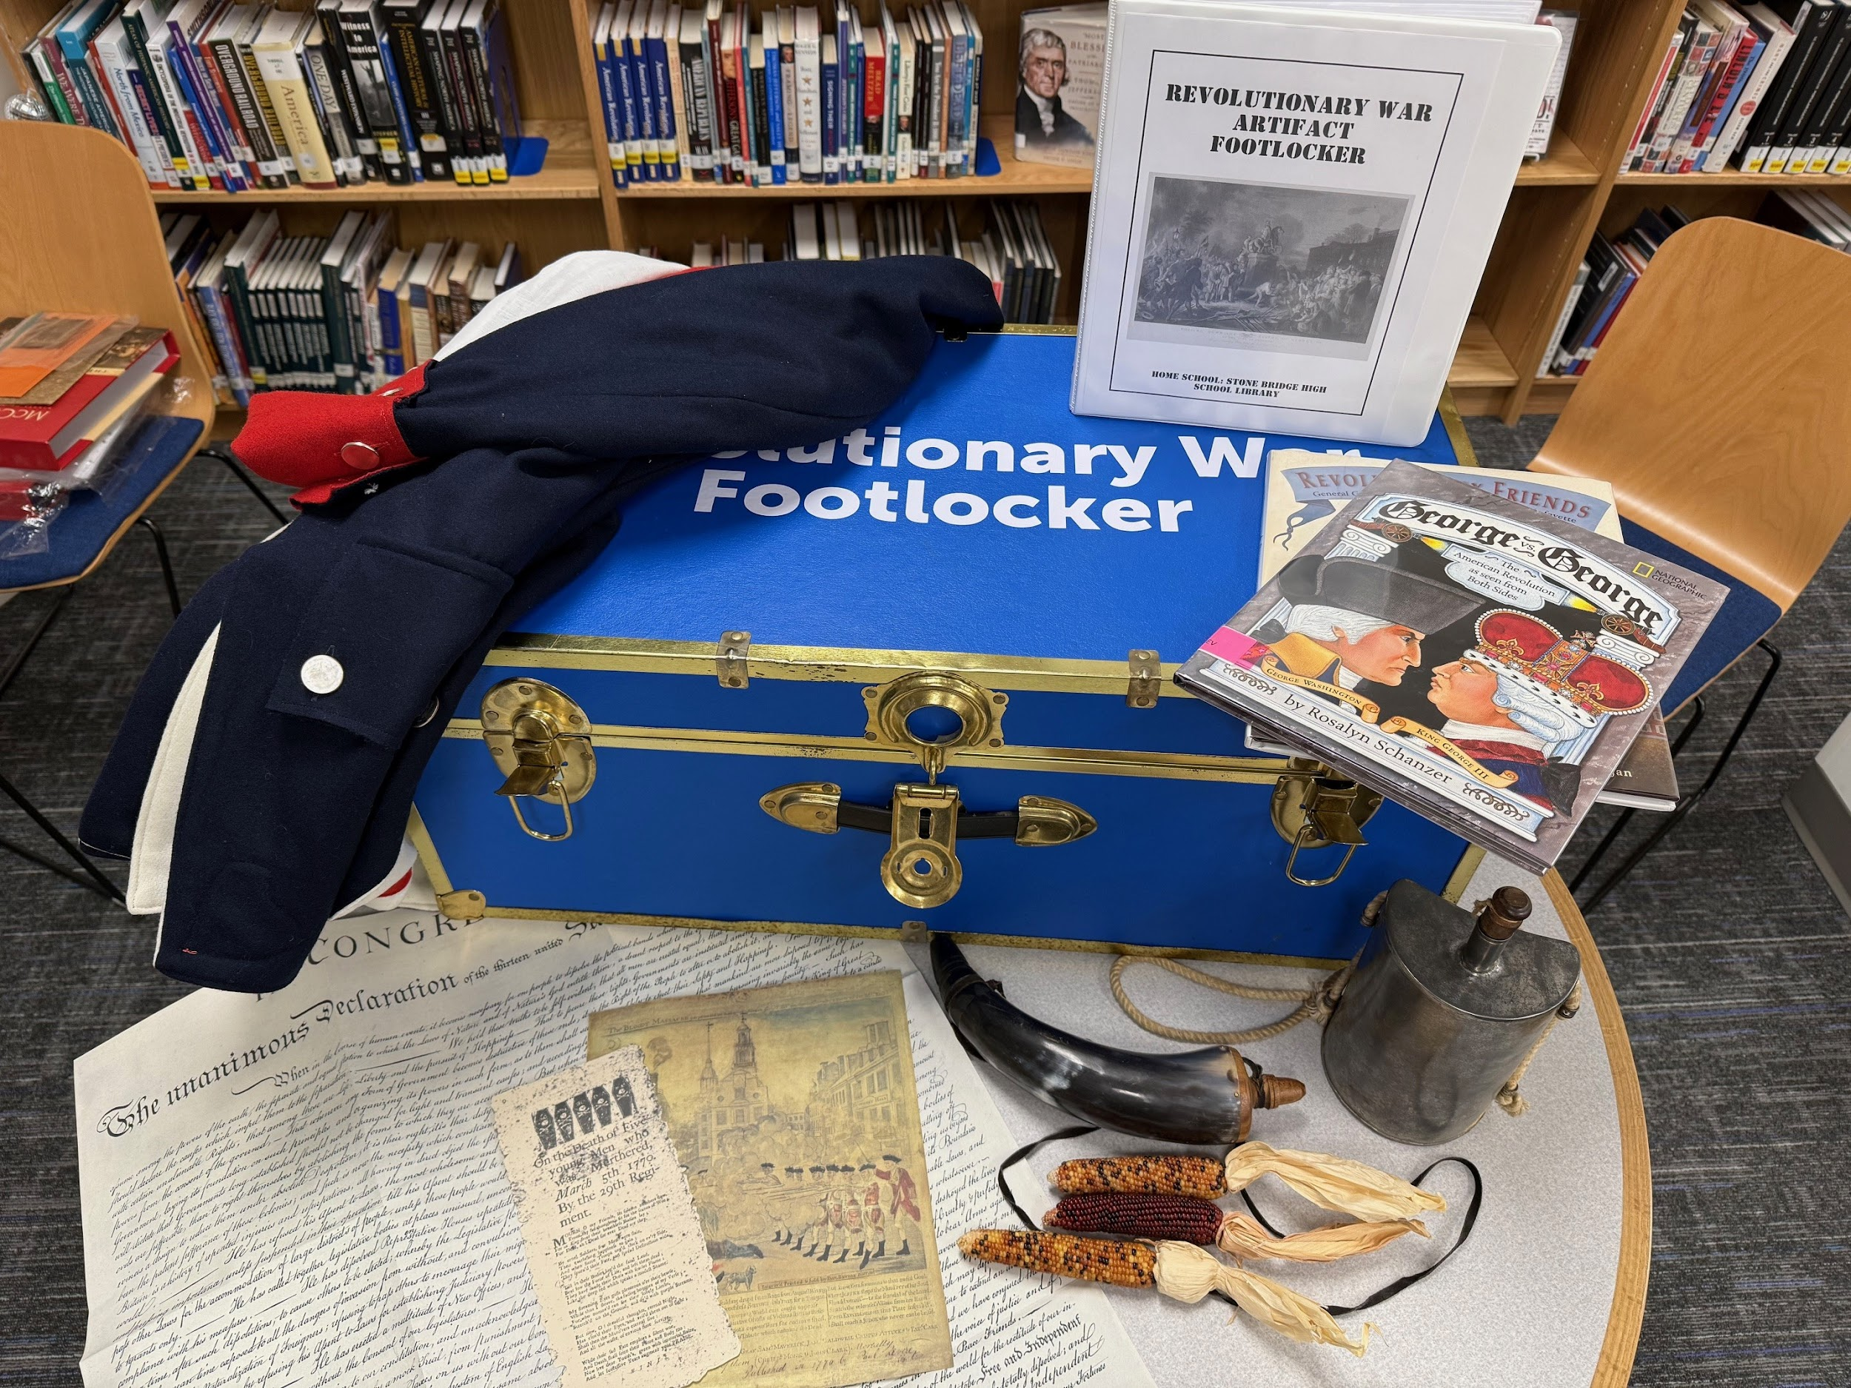
What We’ve Made
Historical Artifact Footlockers for a variety of time periods
American Revolution
World War I
World War II
Cold War (formerly Vietnam War - more on that later!)
Notes:
Done: American Revolution, World War I, World War II, Cold War
In Progress: Civil War, Westward Expansion
Usage stats for first semester:
Three footlockers - WWI, WWII, and Vietnam War
Used 47 times in our building (multiple times, multiple footlockers)
Borrowed by 10 different secondary schools reaching about 4,000 students

Slide 10
How We Started
Reached out to our Library Supervisor at the county-level
Pitched our idea
She had us put together a wish list and she would see what she could do
Starter Pack:
Footlocker
White cotton gloves
Binder for Teacher Guide
Page protectors
Vietnam War replicas from Amazon
About $500
Notes:
Pitched our idea to our Library Supervisor (county-level) - footlocker, gloves, binders, page protectors, a couple Vietnam replicas from Amazon. From there, we created replicas - pro/con buttons, protest photos, local history, draft cards, etc. While it was about $500, the supplies we chose were then used for the following four + footlockers (packs of binders, gloves, etc.)
Since then we haven’t had to purchase any more binders or page protectors yet, and we have four completely done footlockers and several in progress. That was a long term investment. We just bought more gloves since we could potentially have four (or more!) footlockers out at the same time.

Slide 11
Choosing Topics
Social Studies Curricula
What topics will get “the most bang for our buck?”
Notes:
Decided which topics to prioritize by a couple different metrics: What will be able to get artifacts into the hands of the most students? Topics that show up in more than one grade level. How can we connect to local history? What do teachers want? We’ve polled teachers in our building, during PD sessions, etc.

Slide 12
Choosing Topics 1
Social Studies Curricula
What topics will get “the most bang for our buck?”
6th Grade - US History to 1865
7th Grade - US History 1865 to Present
10th Grade - World History & Geography II - 1500 to Present
11th Grade - Virginia & US History
Notes:
Decided which topics to prioritize by a couple different metrics: What will be able to get artifacts into the hands of the most students? Topics that show up in more than one grade level. How can we connect to local history? What do teachers want? We’ve polled teachers in our building, during PD sessions, etc.
We started with Vietnam War because it’s in 7th, 10th, and 11th grades and it’s in one of the harder units of the year. What do you mean we’re fighting but not? Why were we there? Did we win? What’s a proxy war?

Slide 13
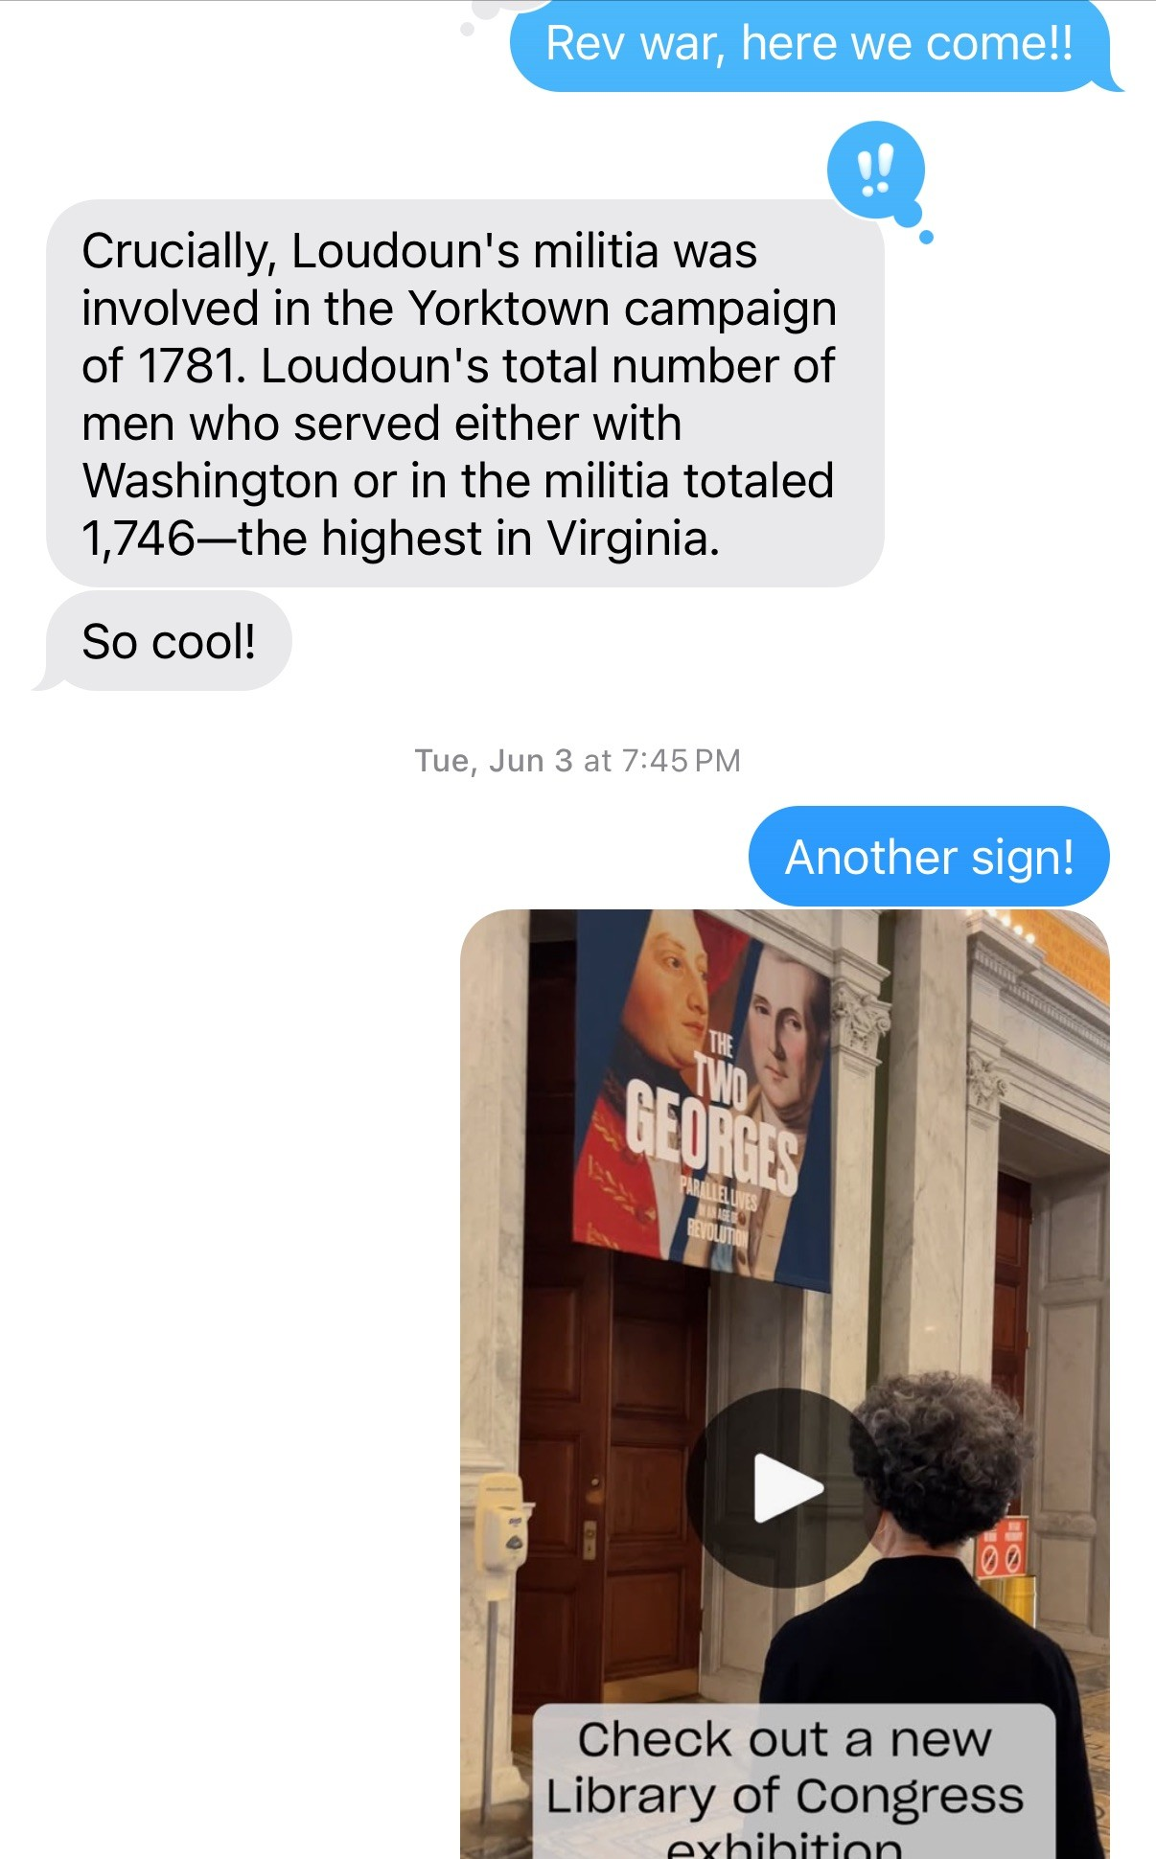
Choosing Topics 2
Social Studies Curricula
What topics will get “the most bang for our buck?”
6th Grade - US History to 1865
7th Grade - US History 1865 to Present
10th Grade - World History & Geography II - 1500 to Present
11th Grade - Virginia & US History
But be prepared to pivot!
Notes:
Decided which topics to prioritize by a couple different metrics: What will be able to get artifacts into the hands of the most students? Topics that show up in more than one grade level. How can we connect to local history? What do teachers want? We’ve polled teachers in our building, during PD sessions, etc.
We started with Vietnam War because it’s in 7th, 10th, and 11th grades and it’s in one of the harder units of the year. What do you mean we’re fighting but not? Why were we there? Did we win? What’s a proxy war?
Within a couple months of “completing” the footlocker, the state SSGS standards changed and Vietnam War was removed from World History curriculum entirely and US classes only needed to know Ho Chi Minh - so what now? Shift to Cold War!
Over the summer, we realized that all the 250th anniversary of the Revolution was happening and we should probably lean into that - so we started researching and putting together purchase orders…

Slide 14








Finding Artifacts - Purchasing
Notes:
Began with items we already had (history nerds, former history teacher - we already had a good amount of “stuff”)
Authentic:
eBay, Facebook Marketplace - these are tricky because we found out we couldn’t be reimbursed for them.
Mini Museum and History Hoard - small authentic items (coins, chain mail, etc.)
Replica:
Amazon, Townsends, World War II Museum, History by Mail (documents), CGSCF (westward expansion)
As we worked on cataloging, organizing, and researching, teachers stopped and asked questions. One teacher brought in a bunch of his uncle’s WWII items from his attic.
We do a good bit of research before purchasing to make sure what we’re buying is real. I purchased a red cross service bar that said it was from WWI, but when talking with our local history friend he pointed out that since it was cloth, it was actually WWII era. That was an easy fix, just switch footlockers, but since then we do a little more research first
People always want to know how much we spend - it depends on the items. Before receiving the ALA grant, we were working with small grants or our own budget so the most expensive items we were purchasing were generally under $75 dollars - uniform items from more recent eras, gas masks, etc. Since we have gotten this grant, we were able to make our largest purchases - a replica Revolutionary war uniform coat which cost around $300 and our traveling poster exhibits, which were just under $1000 each for 7-8 posters designed and printed through Canva. We are very thoughtful about the amount of money we spend on each item since we want to get as much as possible and have the most meaningful items as possible

Slide 15








Finding Artifacts - Replicating
Notes:
Replicas - finding documents, images, diaries, etc. that we could print on cardstock

Slide 16
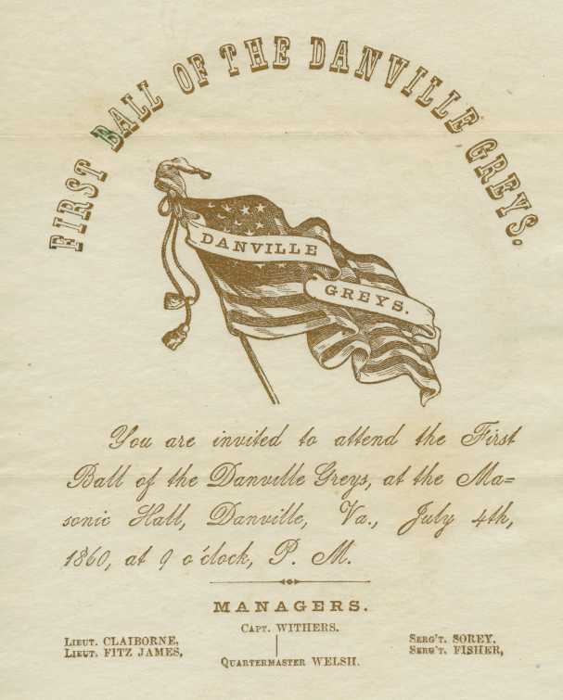
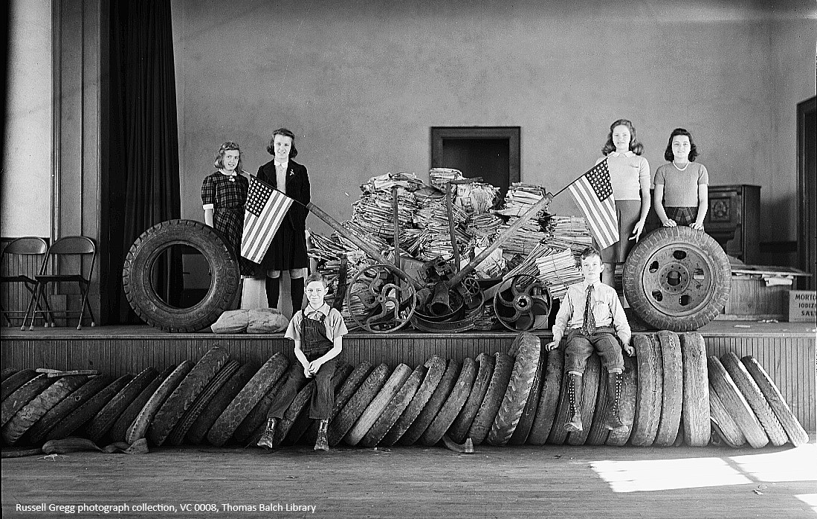
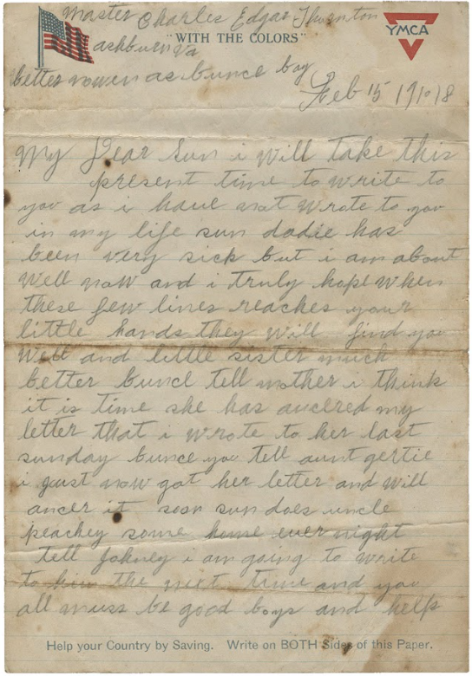
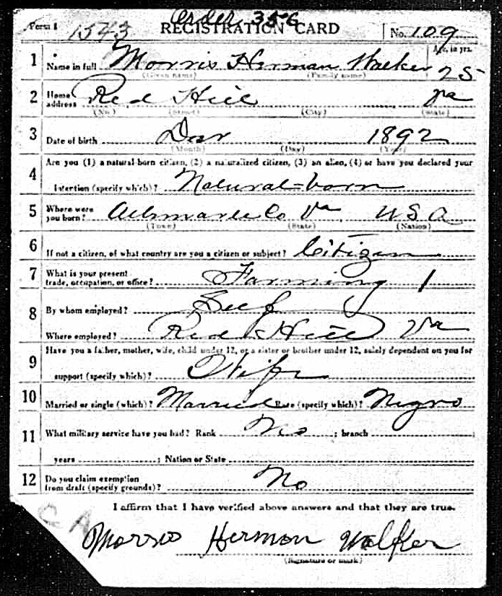
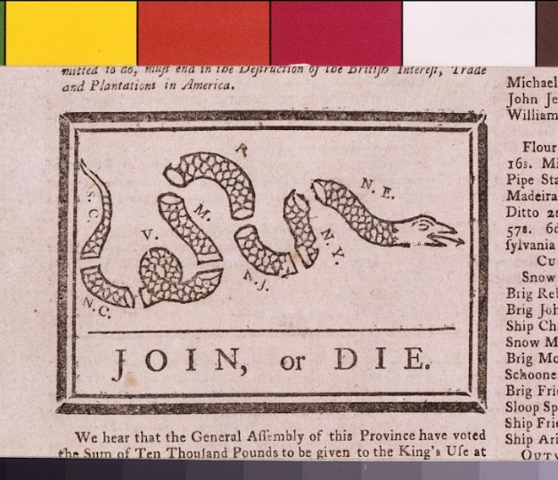
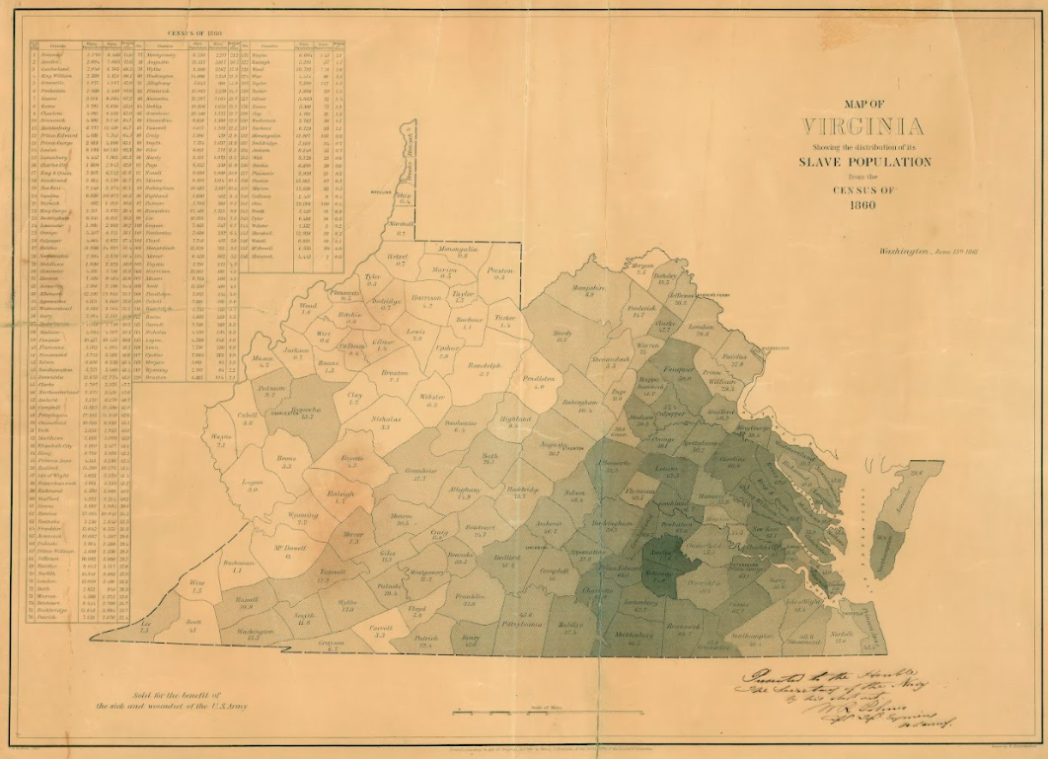
Finding Artifacts – Replicating 2
Notes:
Replicas - finding documents, images, diaries, etc.
We try to use lots of local resources, especially for finding out about local stories (Thornton, Loudoun scrap/tire drives, letters, diaries - Boomerang Cow!, etc.)
Getting a variety of artifacts that represent the wide array of people in history - documents, clothes, bulkier physical items, women, BIPOC/underrepresented stories, etc.

Slide 17
Community Partnerships
Notes:
Two of our most meaningful partnerships have been with the VPHA and Thomas Balch Library
VPHA - put in touch with their Director of Education, Travis Shaw, through the Social Sciences and Global Studies supervisor. We initially started working with to help suggest artifacts and resources. From there we branched out to their public programs coordinator (now Executive Director) Ian MacDougall. These two have been invaluable to helping us find resources, putting us in contact with other groups/organizations.
We began working with Thomas Balch Library to find local resources to make that local connection. They are a history and genealogy library specific to Loudoun County and the surrounding area. Since initially reaching out about accessing local resources, we’ve also begun working on research lessons by time period where their team curates local resources to teach students historical thinking skills and how to read different types of primary and secondary sources. This month to align with Halloween, they are teaching how to read primary and secondary sources via an unsolved true crime from our area called Mystery in the Manuscripts! Reaching out to these two groups has been incredibly helpful both professionally and personally as we’ve been learning so much from them!
If you are planning on creating your own footlocker program - reach out to your local historical societies and organizations! They have been awesome to work with!
While we are lucky to live in a particularly historically-rich area, anyone can reach out to local historical societies. While we like that our particular county has a depth of historical resources we can use, you could even look regionally (like the VPHA) to find those resources for your local area.

Slide 18
Getting Teachers on Board
Signing up for EVERY PD opportunity
Plug and play resources
Something different
Checking out the Footlockers
Through our library program (Follet Destiny) as an ILL - email follow up
Delivery/Pick up and Drop off
Notes:
How to get teachers on board
we go and “sell” our footlockers at every available PD - social studies, english, library - and we go twice a year at county-wide professional development. We send out one pagers about them to our social studies teachers and the secondary librarians in the county for them to share with their social studies teachers
we have created resources that are “plug and play” the teachers and librarians don’t have to do anything other than make copies. This makes it as easy to use as possible, but also allows teachers and librarians to create their own lessons
We have both teachers and students say they are tired of lecture, but they don’t know what else to do. That’s where we come in. We co-teach or plan and teach lessons for teachers all the time, this was just one more tool in our tool belt that we could offer. It’s something different, that most students haven’t encountered before and allows them to “play” with history instead of seeing it as a boring timeline of events. This lets them interact and see that these were real people just like them

Slide 19
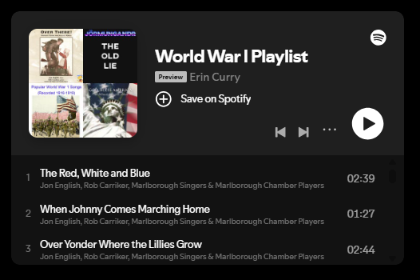
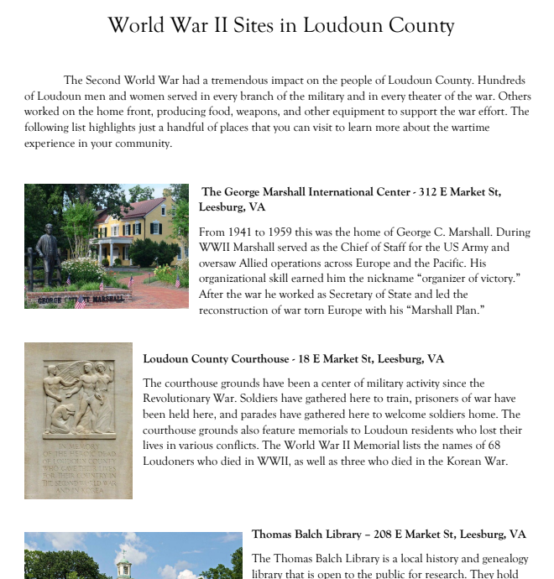
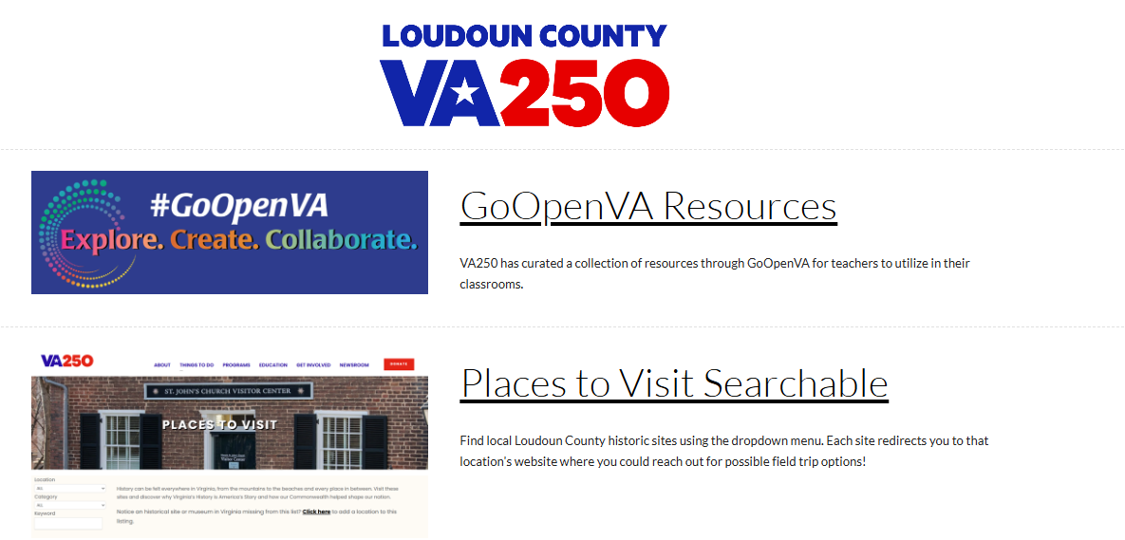
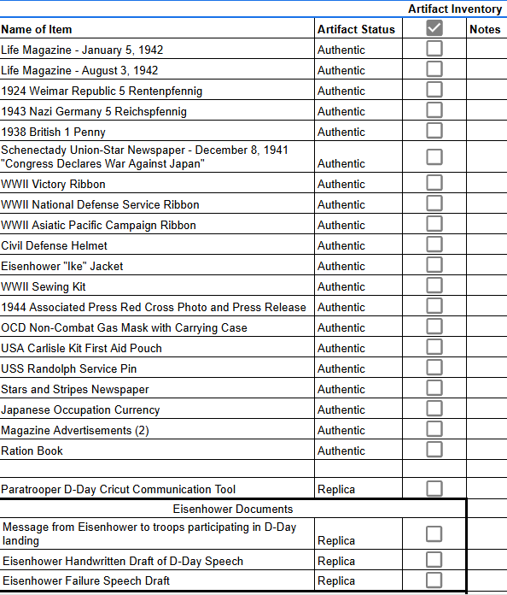
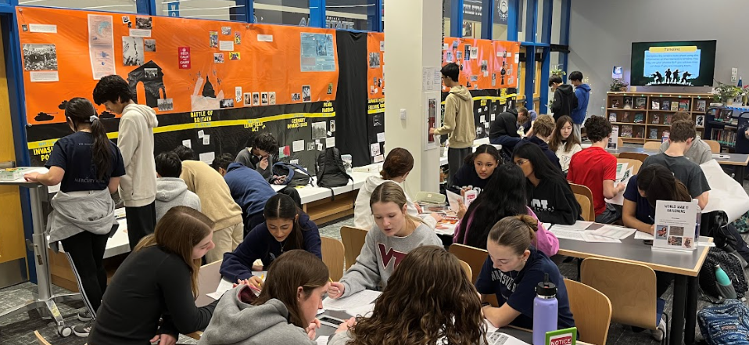
Teacher Materials
Notes:
The primary purposes of our resources are that they help make history fun and interesting for students and that they are as easy to use as possible for teachers. We have a variety of physical and digital resources for teachers to try to make the footlockers as easy to use as possible.

Slide 20
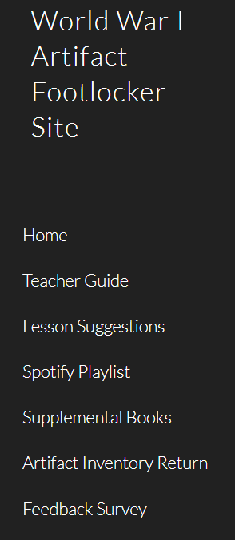
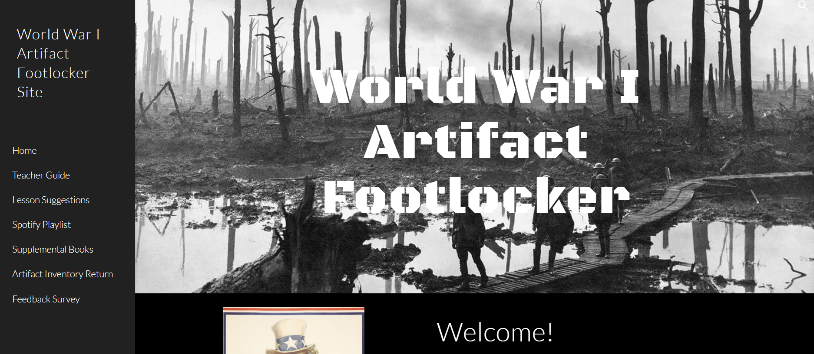
Google Sites
For each footlocker, we have created an accompanying teacher-facing Google Site with materials.
Notes:
Google Sites are LCPS-only access
Copy Site and change settings to Anyone can access or just do walkthrough?

Slide 21
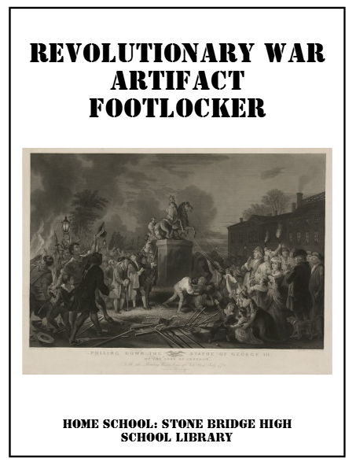
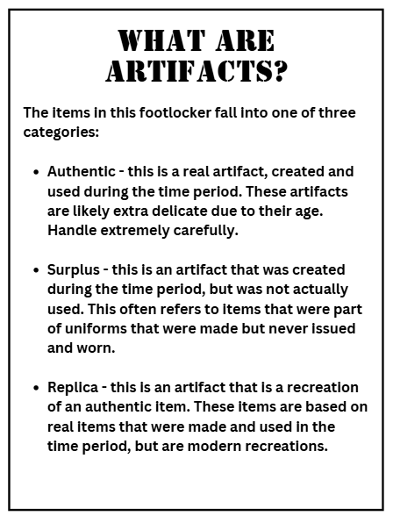
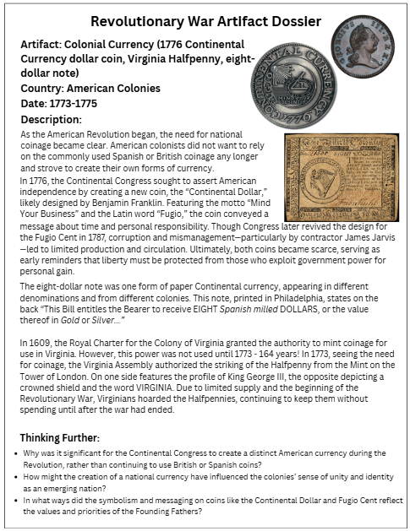
Teaching Guide
Notes:
The Teacher Guide is available physically (a binder located in the footlocker) and digitally (on the Google Site). It contains information about using artifacts in the classroom, state standards connections, an inventory of materials, artifact analysis handouts, and artifact dossiers. Each individual item is researched to provide background about the time period and use of the artifact. Each dossier also has “Thinking Further” questions that ask students critical thinking questions and apply information to present day scenarios.

Slide 22
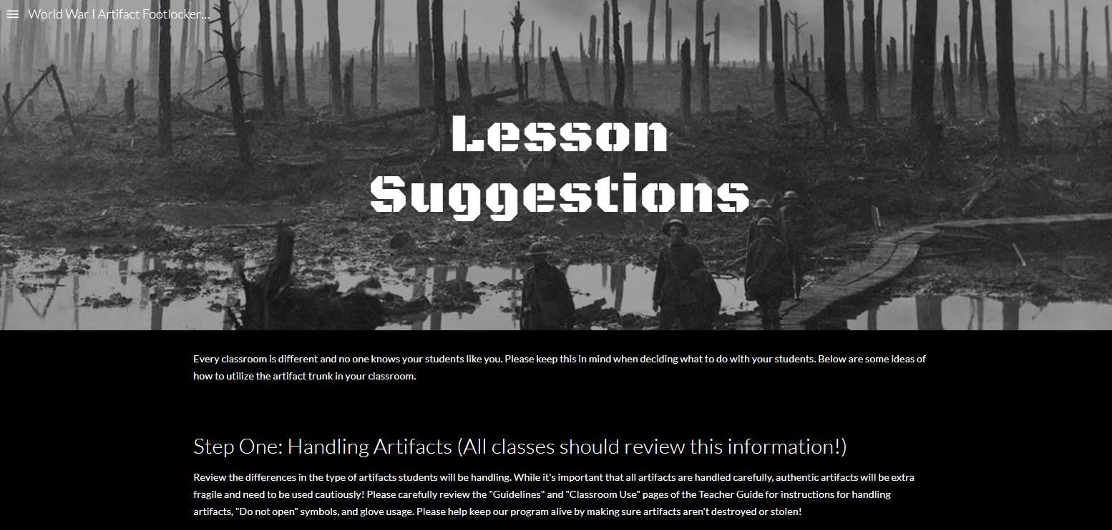
Lesson Suggestions
Notes:
One page of the Google Site is dedicated to using the footlocker - ranging from low tech and low-prep to more in-depth lessons.

Slide 23
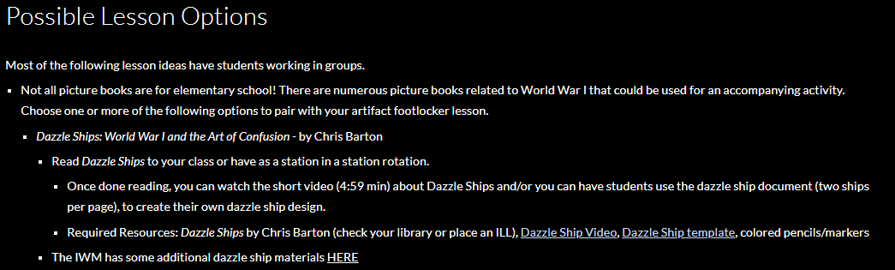
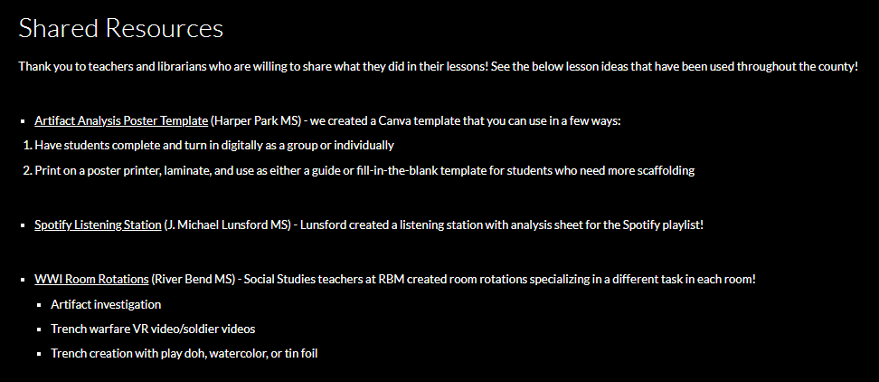
Lessons
Notes:
We try to create activities that hit the 5Cs that are part of the Profile of a Virginia Graduate - Critical thinking, Collaboration, Communication, Creativity, and Citizenship. We have historical picture book read alouds with accompanying activities like designing dazzle ships, knitting from historical patterns, creating museum displays, annotated Declaration of Independence-s, Build Your Own DBQs, etc.

Slide 24
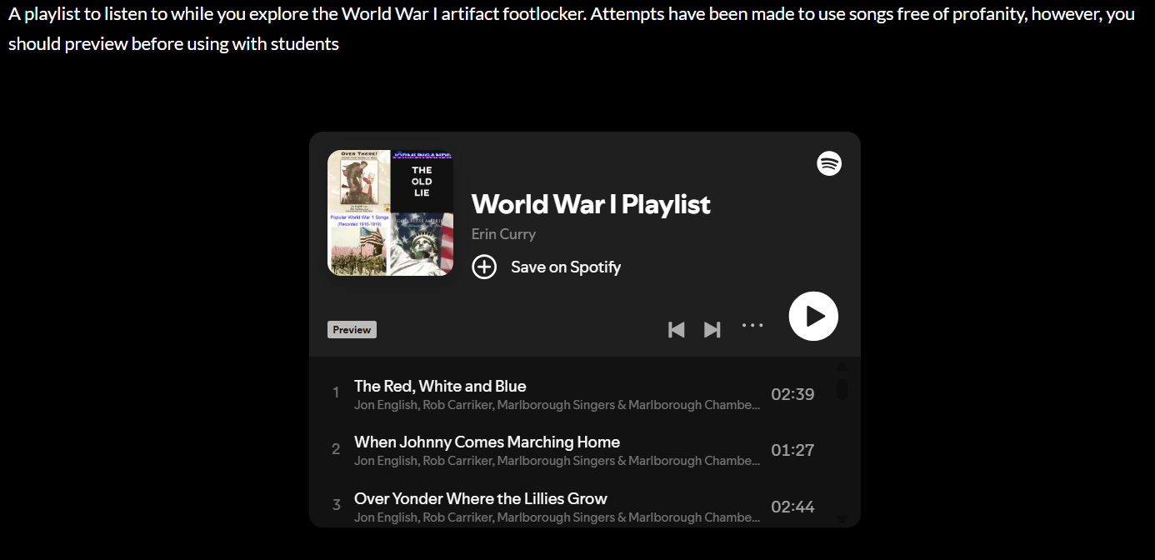
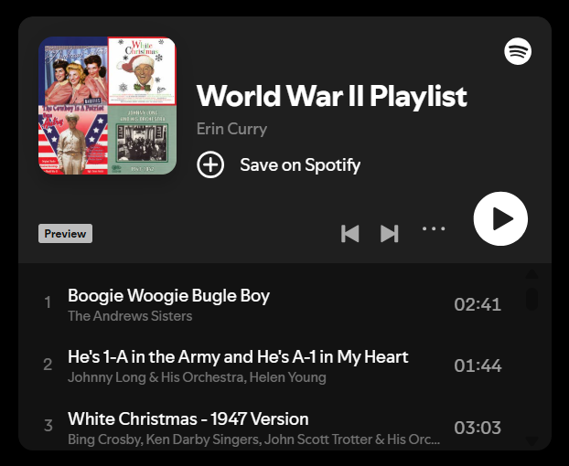
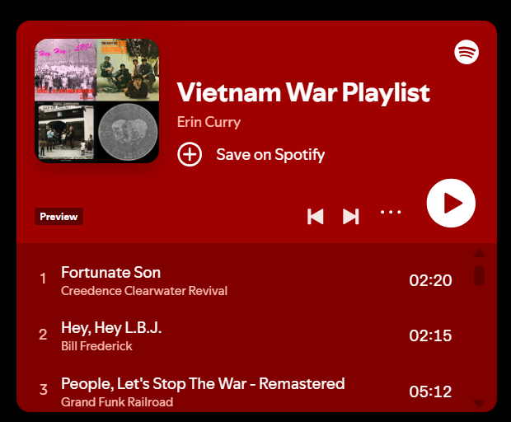
Spotify Playlist
Notes:
Each footlocker has a Spotify Playlist with music from the era. We usually play this in the background while students are working to “set the scene,” but other teachers and librarians have created resources for listening stations where students analyze lyrics and musical components. We’ve also incorporated musical comparisons in stations such as music from the Broadway musical Hamilton in comparison to real life events and even the original World Turned Upside Down folk song.

Slide 25
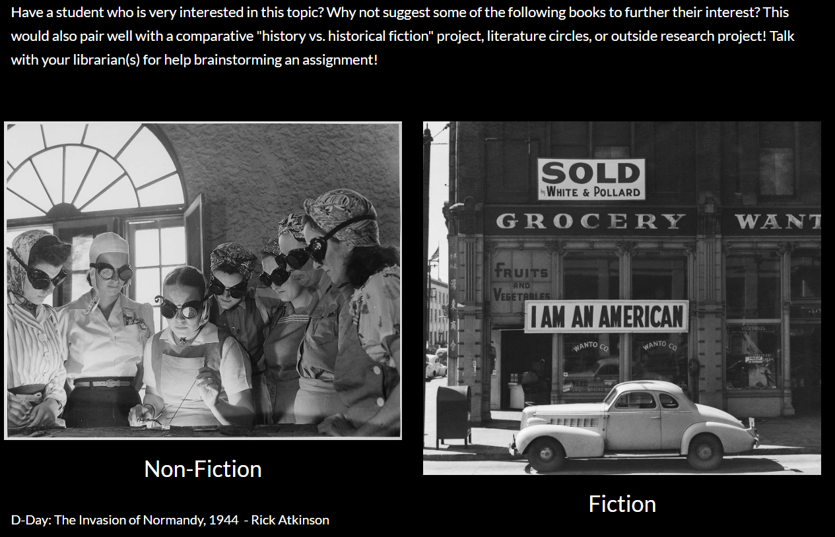
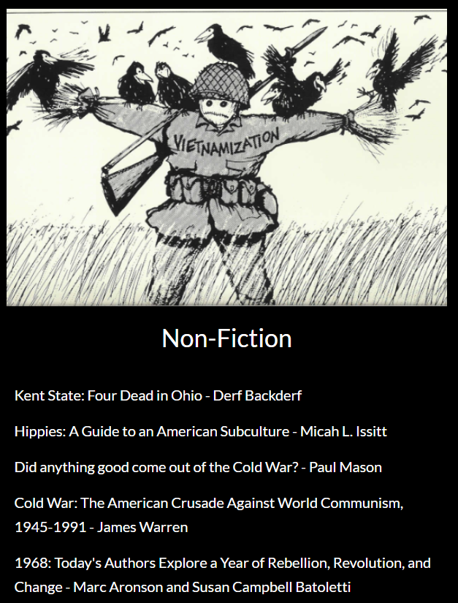
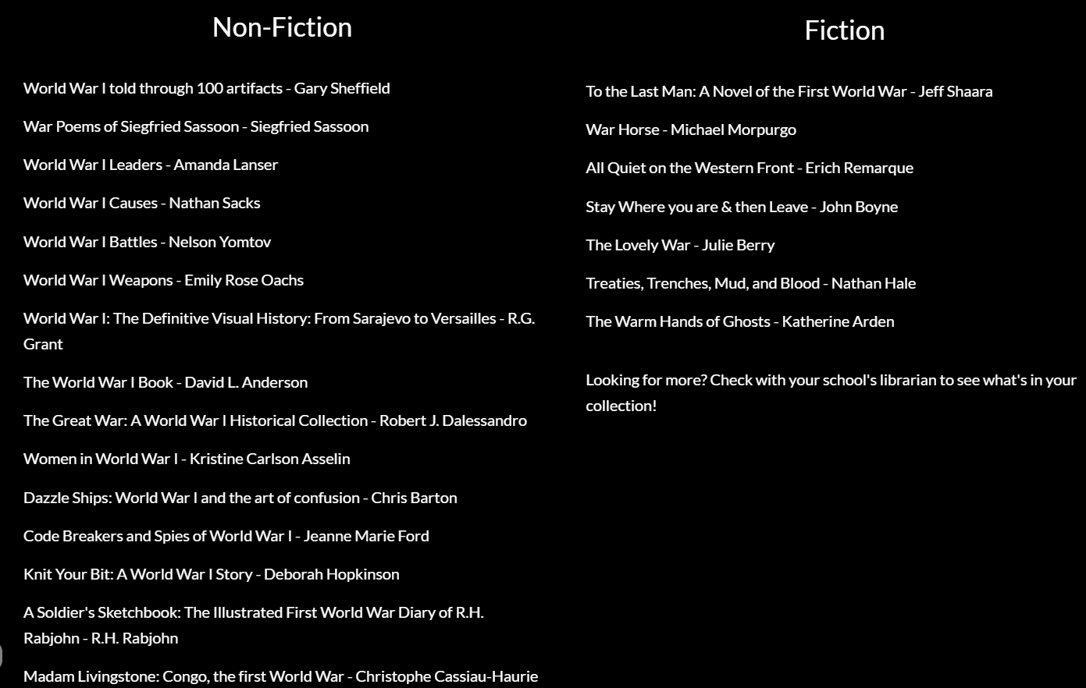
Supplemental Books
Notes:
Because we ARE librarians, we will always recommend books to students and teachers. We have lists of books available in our library for students who want to learn more. We include fiction and nonfiction, and also include some of them in our lesson suggestions.

Slide 26
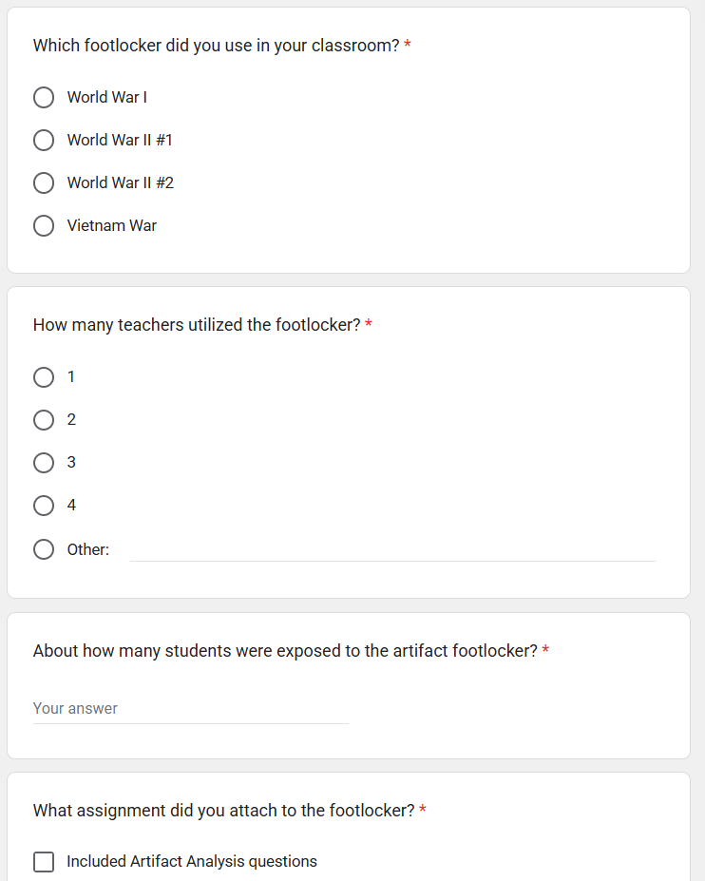
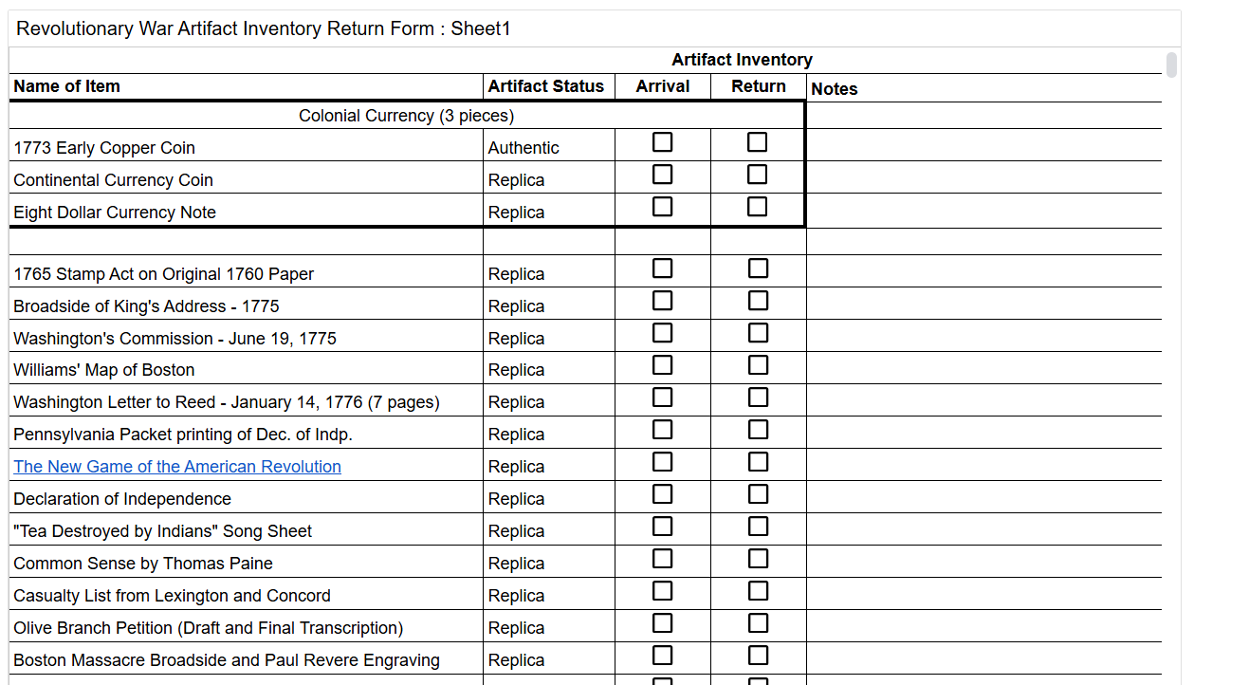
Inventory and Feedback Survey
Notes:
Each footlocker contains an inventory list for teachers/librarians to check upon arrival and before returning. This also allows them to see which artifacts are authentic, replicas, or surplus. There is also a notes section for each, in case of damage, loss, or any other comments that users may have. We also have a feedback survey that allows us to get statistics about usage, how the footlockers were used, and provides a space for teachers and librarians to attach their lesson documents if they would like to share. There is also a comment box for a short answer asking for suggestions, feedback, and requests for the future. We always want to improve, so we encourage feedback!

Slide 27
Looking Forward…
In Progress
On the Horizon
Footlockers
Civil War
Westward Expansion
Ancient World Civilizations
Traveling Poster Exhibits (thanks to ALA, we now have two sets!)
Footlockers
Civil Rights Movement
Multiples
Elementary-level boxes and footlockers
Notes:
As we move forward, we have already begun expanding our offered footlockers to include Civil War (the most requested footlocker by teachers), Westward Expansion, and Ancient World Civilizations. We have also created our first two Traveling Poster Exhibits that align with the content in the footlockers. We have completed the Revolutionary War and World War I posters and are working toward creating a set for each of the completed footlockers. We have begun collecting items to support the Civil Rights Movement and expanding our existing footlockers into multiples so more than one school can use them at a time.

Slide 28

Questions?
Notes:
Thank you both for an insightful presentation! Now we would like to open it up to questions from the audience. Please submit your questions using the Q&A function, that will be the easiest for us to monitor, but I’ll also check the chat in case any questions have come through there.

Slide 29
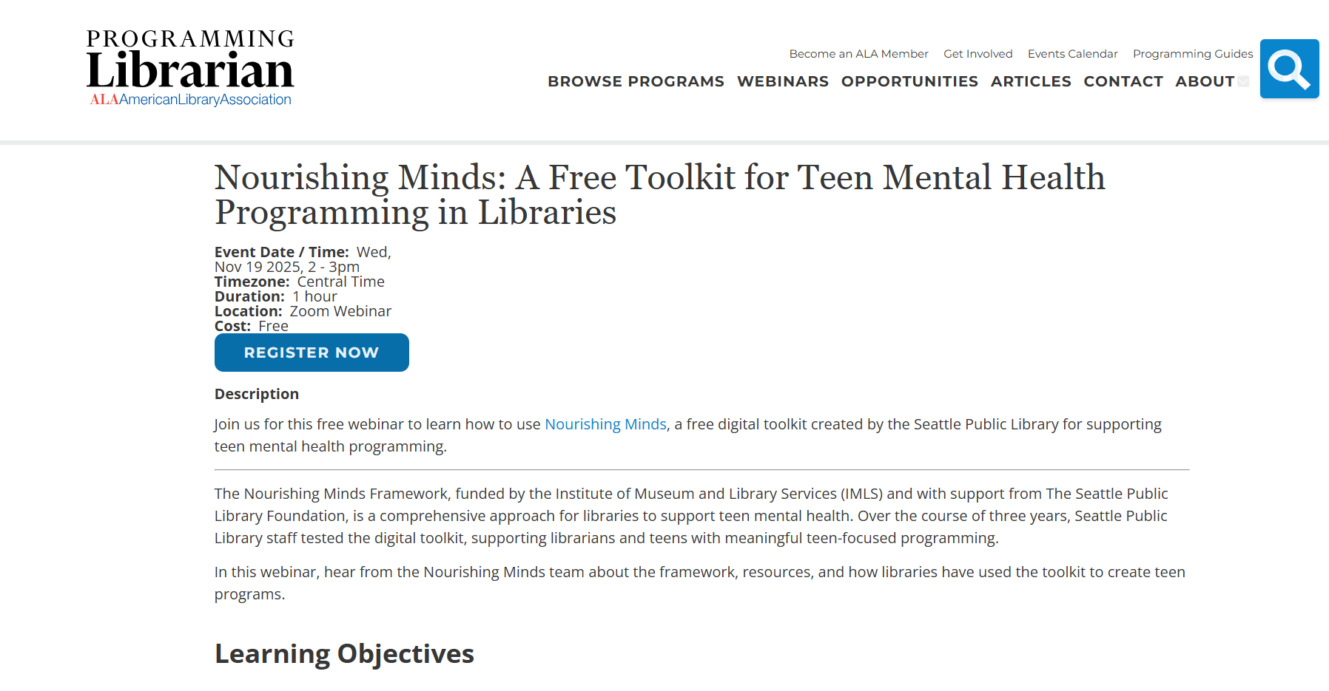
ProgrammingLibrarian.org
Notes:
Thank you to our presenters, Erin and Laura, for sharing the work that went into their award winning Historical Footlocker program! And thank you to my Public Programs Office colleague Meghan Gieseker for helping out behind the scenes with technical support today. And finally, thank you all for taking time out of your day to attend this webinar! Before we go, I would like to invite you to register for our upcoming Programming Librarian webinar “Nourishing Minds: A Free Toolkit for Teen Mental Health Programming in Libraries”. I’ll put the link to that in the chat. The recording of this webinar will be posted on ProgrammingLibrarian.org in the next 48 hours. There are a wealth of additional library programming resources on our site, so I hope you’ll check it out. Thank you and have a great day!

