Slide 1



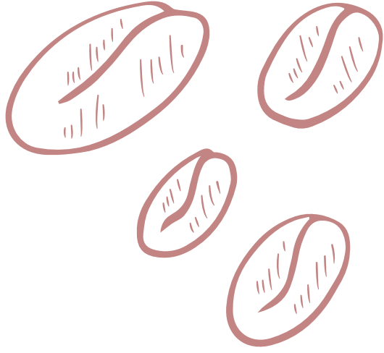







NOVEL
BREWS

Slide 2
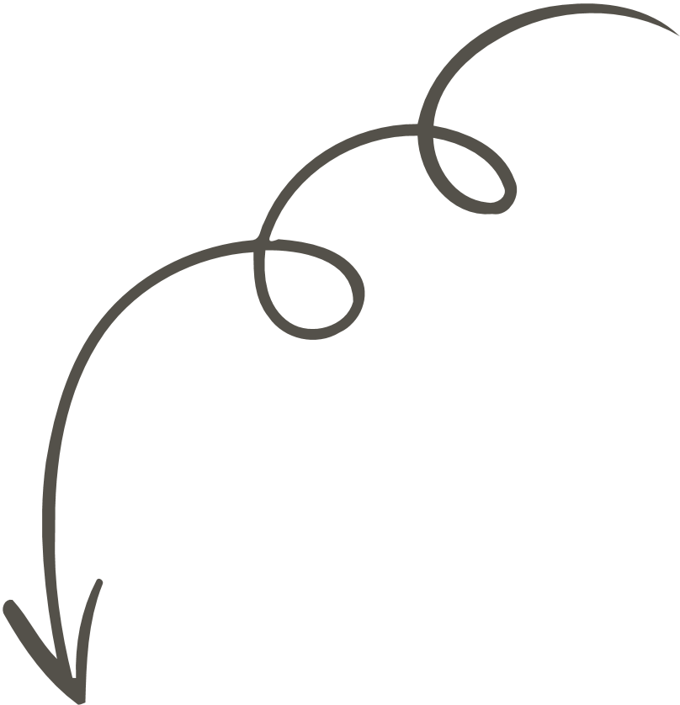

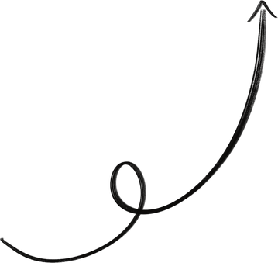
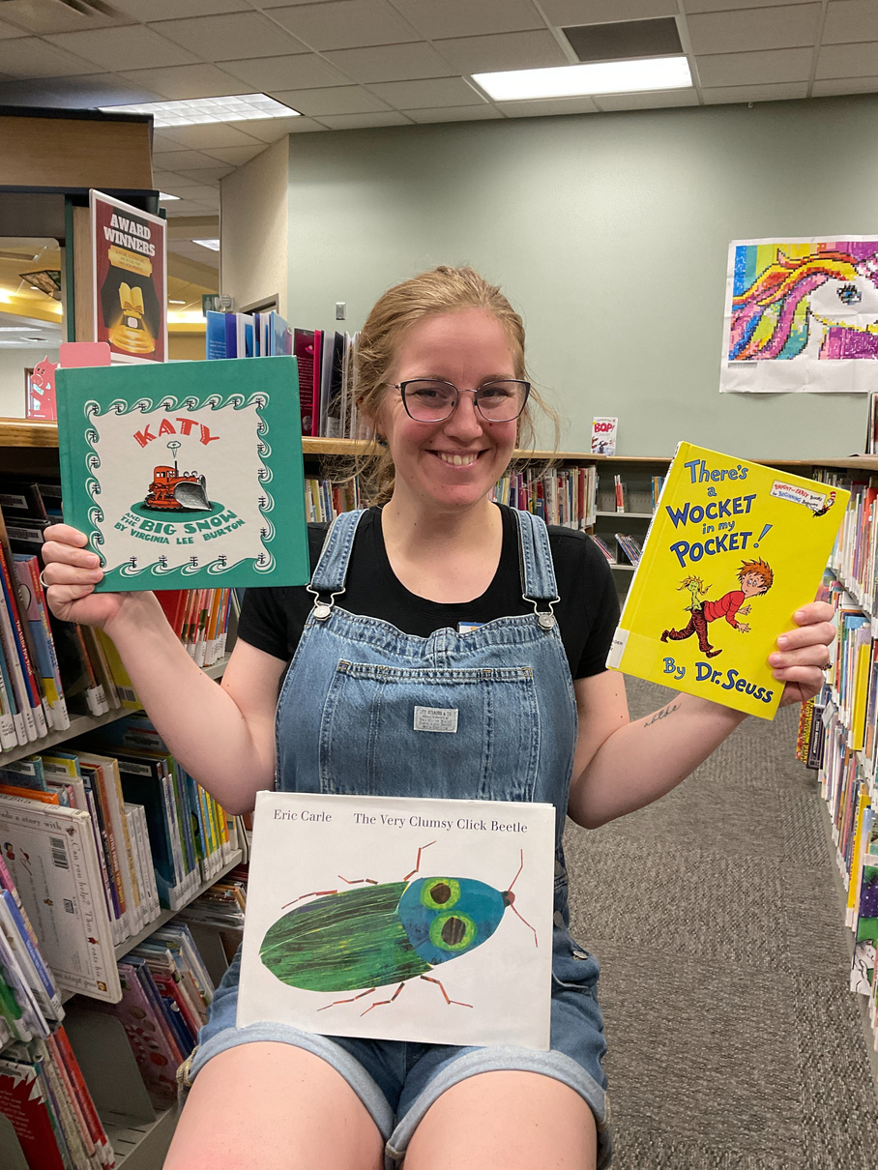
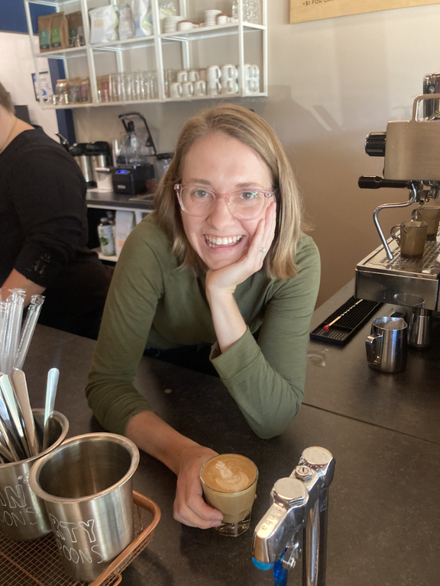

ABOUT US
VICTORIA AND MCKENZIE

Slide 3






FUN FACTS ABOUT COFFEE
THE WORLD CONSUMES CLOSE TO 2.25 BILLION CUPS OF COFFEE EVERY DAY.

Slide 4


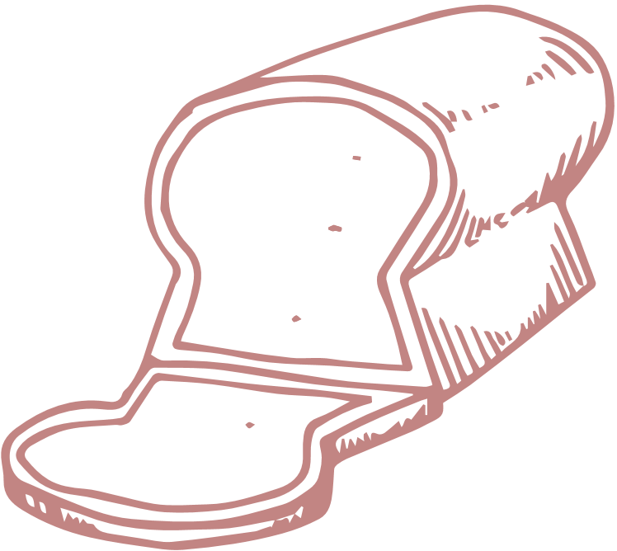


HISTORY OF COFFEE
BOSTON TEA PARTY, 1773
SHIFT TOWARDS QUALITY, 1970S
THIRD WAVE COFFEE
To protest the tea tax, and stick it to Earl Grey, Americans started drinking more coffee instead of tea.
Peet’s Coffee & Tea - 1966
Starbucks - 1971
Marketed as quality coffee instead of coffee of convenience. Erna Knutsen coined the term “Specialty Coffee” in 1978.
starting in the 1990s, specialty coffee shops began popping up all over the USA. Individual shops begin sourcing and roasting their own beans, and create specialty brew methods.

Slide 5




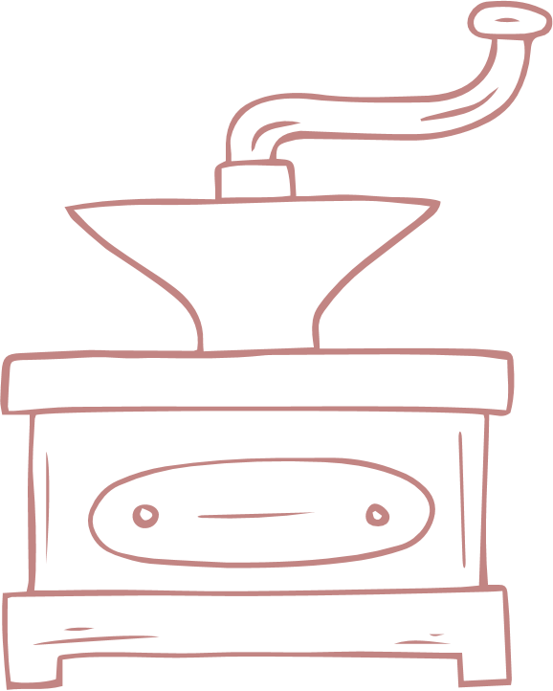


BREWS TODAY
1
BLEND DRIP
4
SPECIALTY LATTE
2
COLD BREW
5
EARL GREY TEA
3
SINGLE ORIGIN DRIP
6
DIRTY CHAI

Slide 6

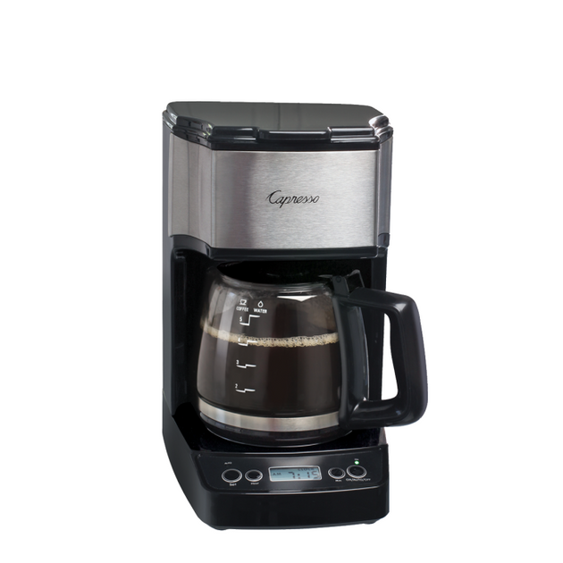


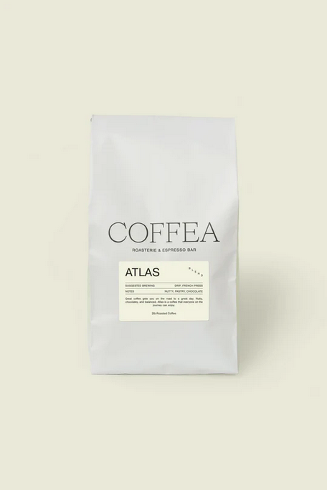
ATLAS, DRIP
Blend of beans
Roasted in Sioux Falls, SD
Drip preparation
FLAVOR NOTES
Nutty
Pastry
Chocolate

Slide 7

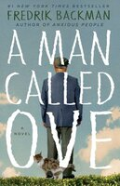



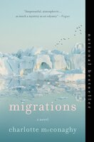
BLEND DRIP VIBES & BOOKS
“REGULAR COFFEE”
BITTER/ACIDIC
ADD CREAM
The Poppy War
A Man Called Ove
The Widow
by Fredrik Backman
by R. F. Kuang
by John Grisham
MORNINGS
BROODY
Cornhuskers
Migrations
by Carl Sandburg
by Charlotte McConaghy

Slide 8


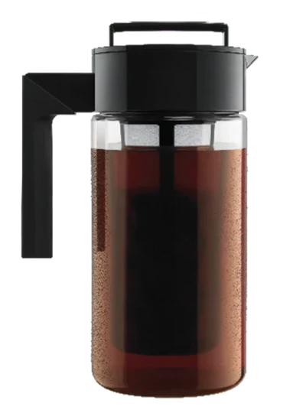

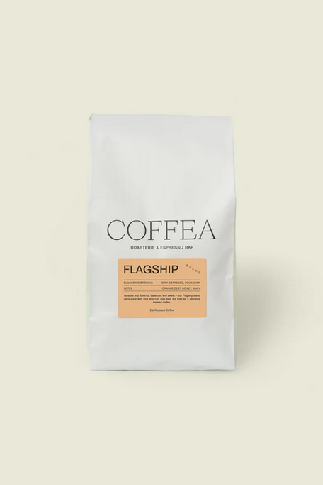
FLAG SHIP, COLD BREW
Blend of beans
Roasted in Sioux Falls, SD
Cold Brew Preparation
FLAVOR NOTES
Orange Zest
Honey
Juicy

Slide 9
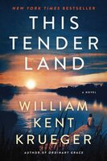
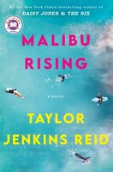
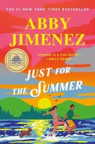

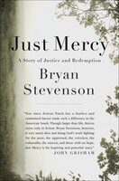
COLD BREW VIBES & BOOKS
SUMMER-Y
YOUNG
QUICK AND EASY
This Tender Land
Malibu Rising
Just For the Summer
by William Kent Krueger
by Taylor Jenkins Reid
by Abby Jimenez
AFTERNOON
STUDY SESSIONS
The Rosie Project
Just Mercy
by Graeme C. Simsion
by Bryan Stevenson

Slide 10
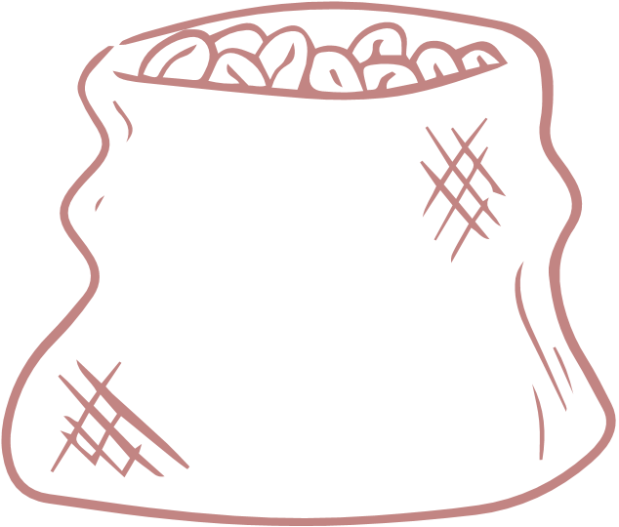
SINGLE ORIGIN DRIP
TBD
FLAVOR NOTES
TBD

Slide 11


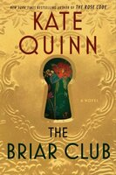


SINLGE ORIGIN VIBES & BOOKS
S HEMISPHERE
TRAVELING
BIG CITY
Violeta
A Walk in the Woods
The Briar Club
by Isabel Allende
by Bill Bryson
by Kate Quinn
UP ALL NIGHT
SLOW BURN PLOT
The Buffalo Hunter Hunter
Cloud Cuckoo Land
by Scott Smith
by Anthony Doerr

Slide 12


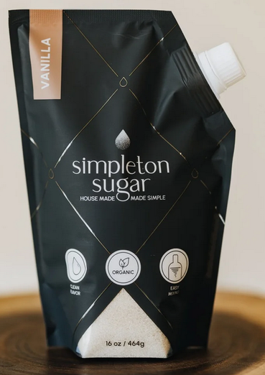

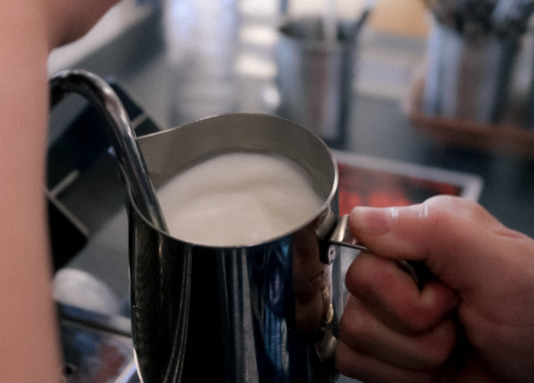
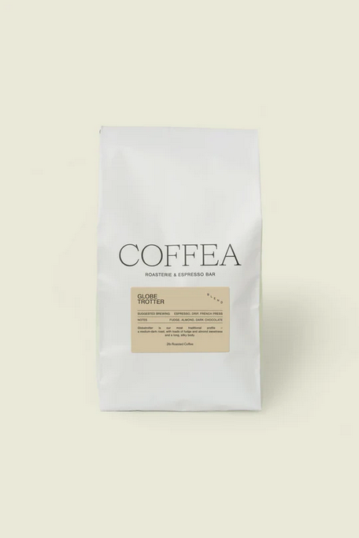

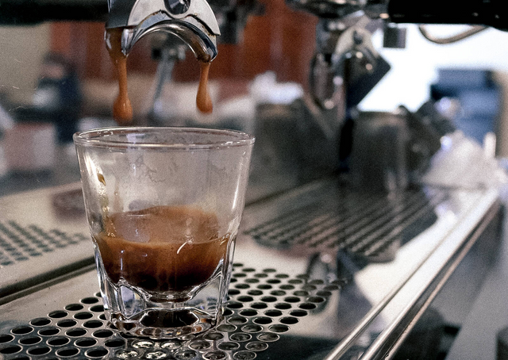
VANILLA LATTE
Globe Trotter Blend
Espresso Brew
Steamed Milk
Flavored syrup
FLAVOR NOTES
Vanilla
Almond
Milk/cream

Slide 13

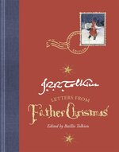
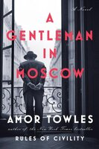
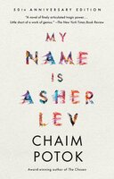

VANILLA LATTE VIBES & BOOKS
“FRU-FRU”
HOLIDAY
MELLOW
What you are looking for is in the library
Letters from Father Christmas
A Gentleman in Moscow
by Michiko Aoyama
by J. R. R. Tolkien
by Amor Towles
OVERLOOKED CLASSIC
VERSTILE
The Waste Land
My Name is Asher Lev
by T. S. Elliot
by Chiam Potok

Slide 14

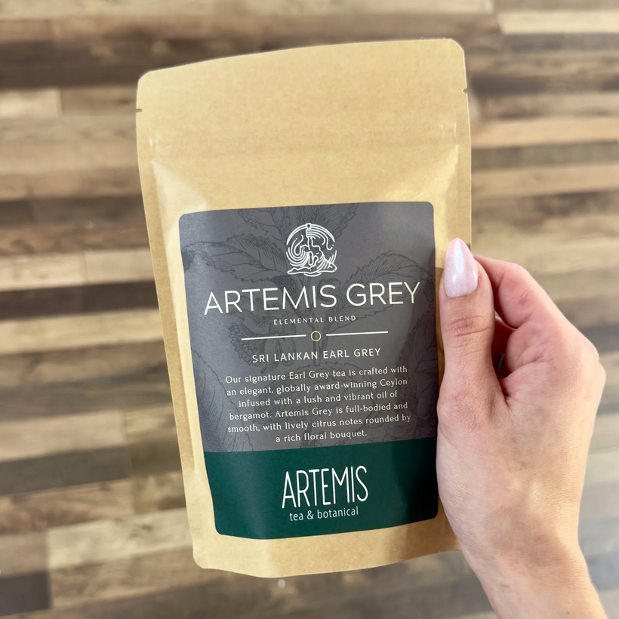



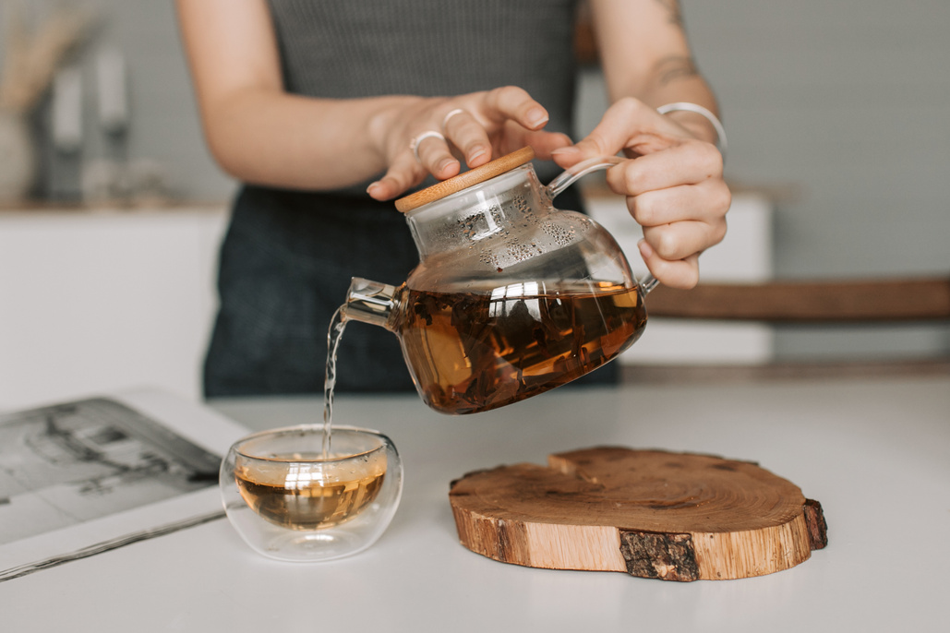
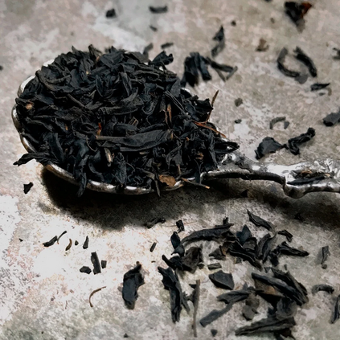
ARTEMIS GREY TEA
Sri Lanka Earl Grey
7 Minute brew time
FLAVOR NOTES
Bergamot
Citrus
Floral

Slide 15
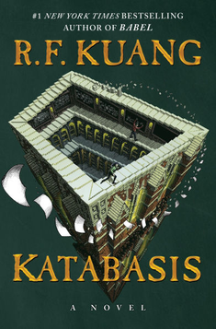
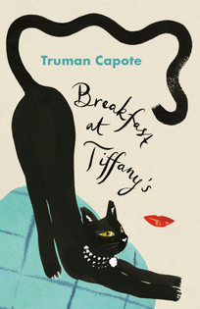

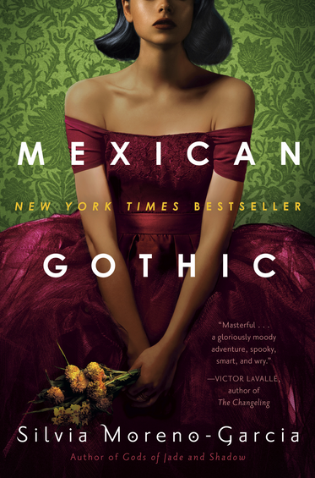
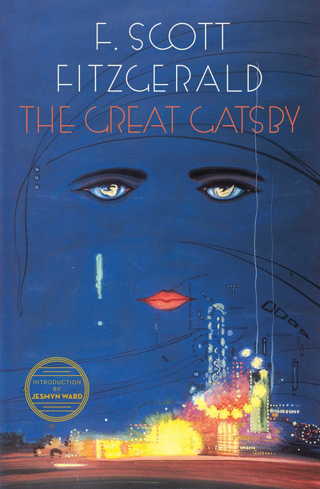
EARL GREY VIBES & BOOKS
ACADEMIC
SOPHISTICATION
CAPTAIN PICARD
Katabasis
Breakfast at Tiffany’s
The Hitchhiker’s Guide to the Galaxy
by R. F. Kuang
by Truman Capote
by Douglas Adams
FOGGY
CLASSIC
Mexican Gotich
The Great Gatsby
by Silvia
Moreno-Garcia
by F. Scott Fitzgerald

Slide 16
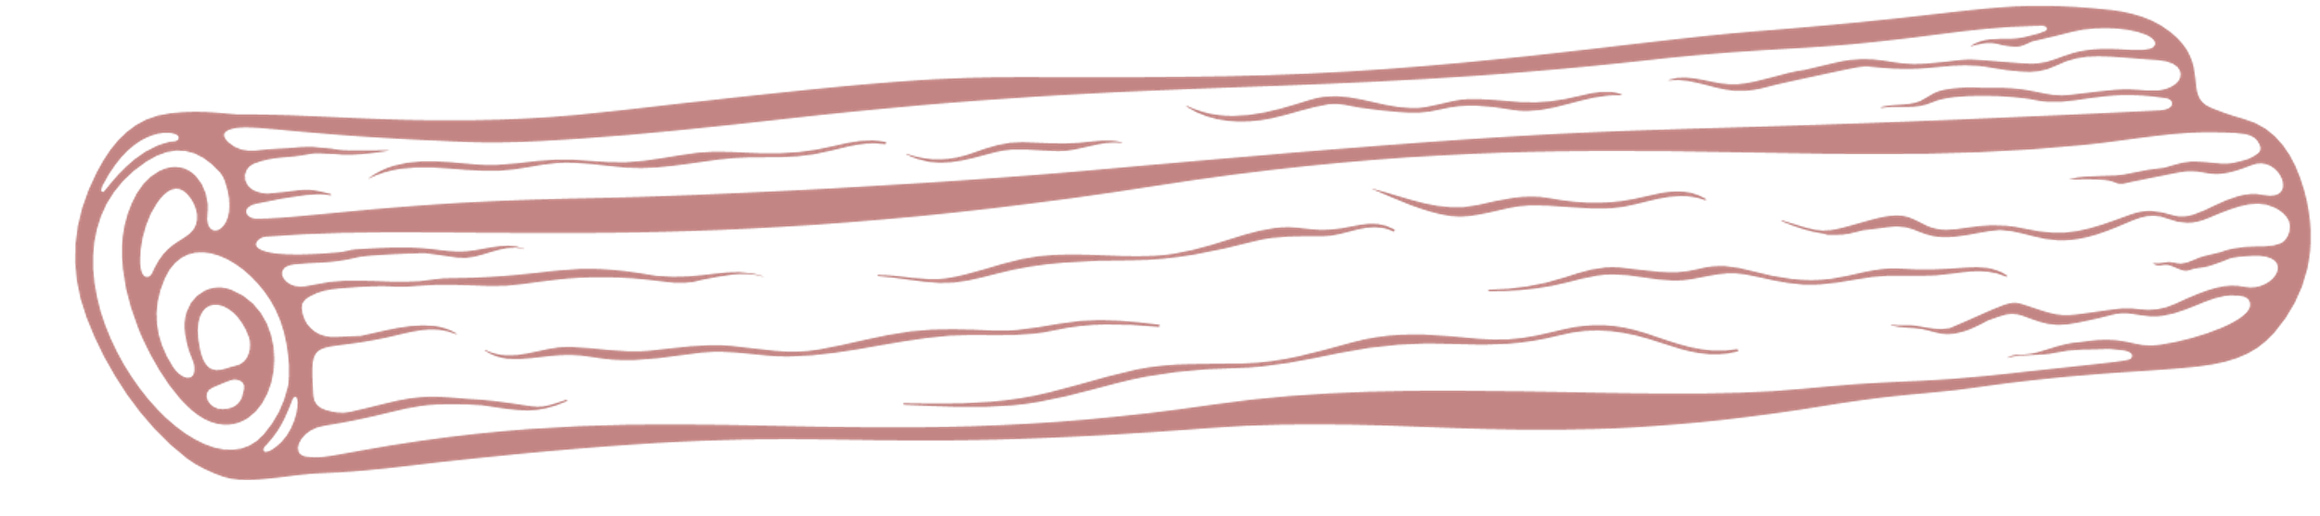
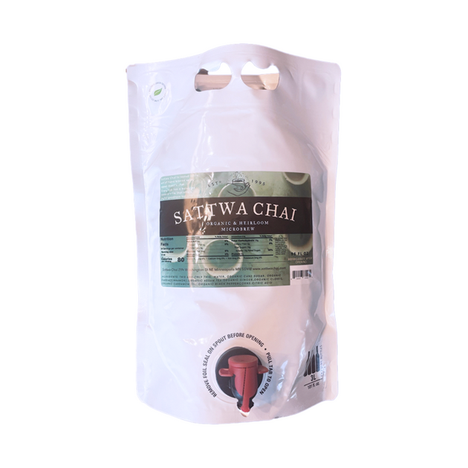


DIRTY CHAI
Chai Tea Concentrate
Espresso Shot
Steamed Milk
FLAVOR NOTES
Cinnamon
Clove
Ginger

Slide 17

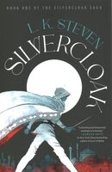
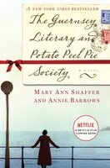

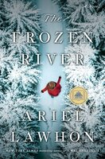
DIRTY CHAI VIBES & BOOKS
FALL
DIRTY ;)
COZY HISTORICAL
Sisters in the Wind
Silvercloak
The Guernsey Literary and Potato Peel Pie Society
by Angeline Boulley
by L. K. Steven
by Mary Ann Shaffer
UNEXPECTED FRIENDS
WINTER
The Reading List
The Frozen River
by Sara Nisha Adams
by Ariel Lawhon

Slide 18



GET YOURSELF A LIBRARY CARD
MAKE YOUR OWN RECOMMENDATIONS
NOW WHAT?
SPREAD THE WORD TO YOUR FRIENDS!

