Slide 1

11/24/25
Intro to
Zines
For tweens and teens

Slide 2

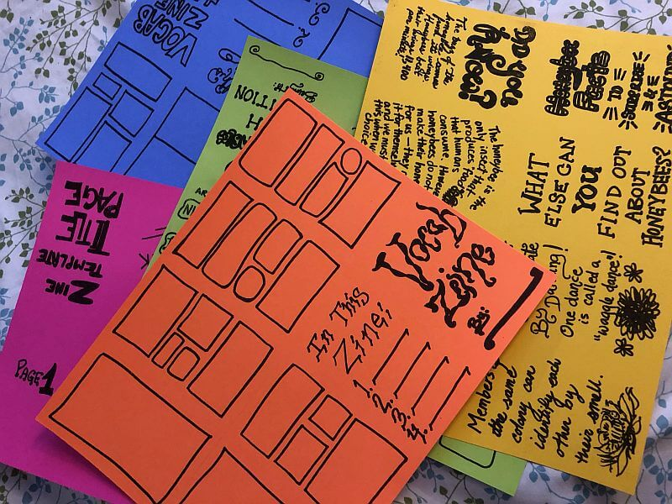
INTRO

Slide 3

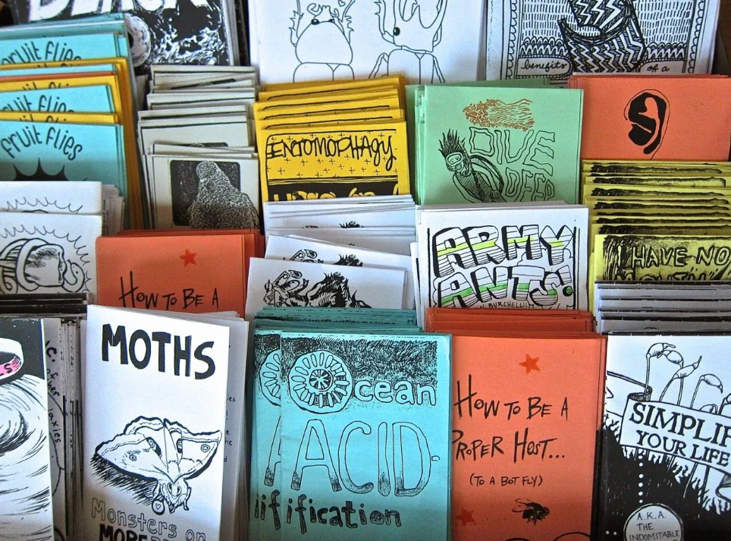
Zines are:
Small, self-published booklets that can be about anything: art, stories, poetry, fandoms, social issues, or just your personal thoughts.
Have been around for decades as a way for people to share their voices outside of mainstream publishing.
Zines are usually handmade, photocopied, and traded or given away, making them a creative and accessible way to express yourself.
What are zines?

Slide 4

What are they about?
ANYTHING!

Slide 5


And many more!
Perzines
Literary zines
Fanzines
Photozines
Comics
DIY or How To zines
Artzines
Politicalzines
Activistzines
PERZINE
FANZINES
COMICS

Slide 6
Where to start
How
Pick a theme
Writer’s block?
Make a list of things you love and things you hate
Pick one of these!
How?
Canva
Hand written
Hand illustrated
Collage

Slide 7

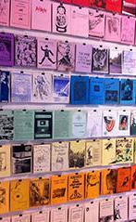



What to put in them
Writing
Images
Draw something, cut and paste from magazines, use images found online
Write stories, facts, shared experiences, poems

Slide 8

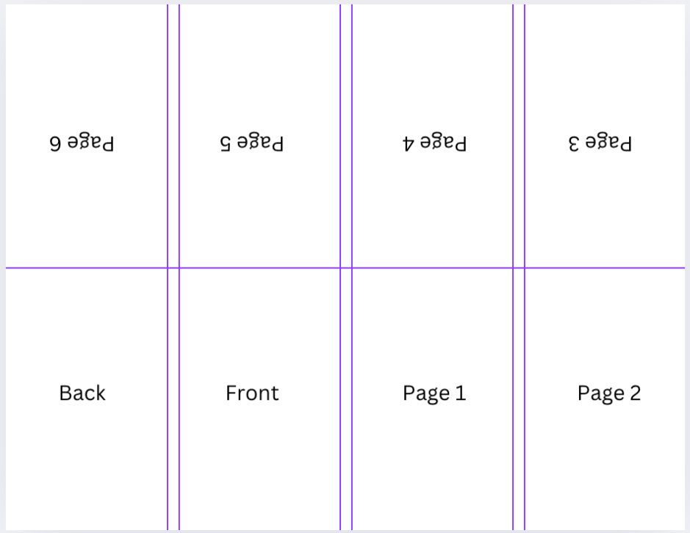
THE LAYOUT
Notice the purple lines: this is where the paper will be folded
Notice the order in which the flow is - some are upside down, and the page begins at the bottom left with the back page

Slide 9
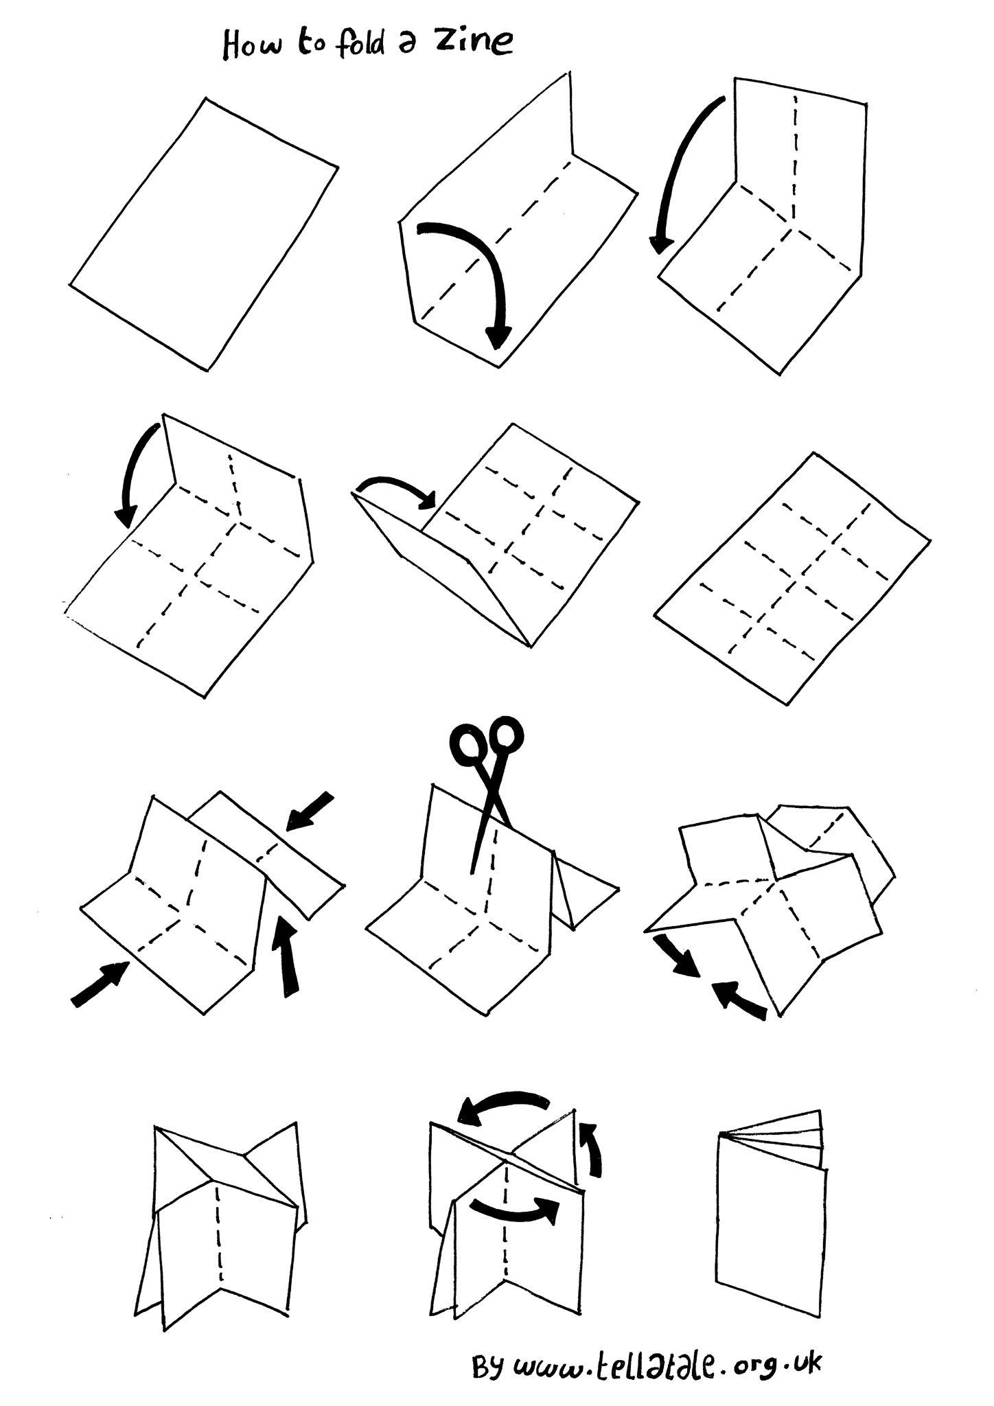
Now what?
Once you have filled in all 8 portions of your zine, it’s time to fold and cut!

Slide 10


PUT IT IN PRINT
Making copies lets you share your zine with more people while keeping your original safe.
  How to do it:
  Flatten your zine so it copies clearly.
  Use black & white for a classic zine look, or color if you want it bold.
  Double-check that pages are in the right order before making multiple copies.
  Share it:
  Once you’ve made copies, add one to our
  Free Zine Library so others can read your work!
  Keep a few for trading or giving to friends!

Slide 11

KEEP ZINE-ING
Your voice is important and someone may be feeling the same way!
It’s also important to share the things that are important to you - we all love learning!
Dabble with digital and physical zines - the possibilities are endless :)

