Slide 1

BUILDING FUTURES
OPL Elmhurst Skilled Trades Mini Career Fair,
January 31, 2026
OPL Commission Meeting, April 27, 2026
Hosted at OPL Elmhurst

Slide 2
About Ourselves and Our Vision
Nichole Brown, OPL Elmhurst Branch Manager
Christina Jenq, PhD, Oakland community member
Labor economist
Workforce development interests

Slide 3
Our Goals and Perspectives
Community prosperity
National perspective
Major shortages of skilled tradespeople
A local library is a strategic venue to fill this need
Trusted role in the community
Welcoming, easy-to-access space for people from all backgrounds to explore career paths
Notes:
In an environment of fragmented workforce development initiatives at all levels of government that often do not deliver measurable or meaningful results, my collaborator and I see that libraries, already embedded in communities and trusted, are an underutilized strategic player in workforce development initiatives that can deliver bottom-up prosperity to economically discouraged communities.
OPL Elmhurst is a small branch embedded in a more economically depressed community in deep East Oakland, and we executed this with a limited budget, and limited outreach efforts.
We wanted a minimum of 50 people to show up, hopefully 100. We ended up in the high 100's. Participants came from as far as Dublin and Sacramento, and everyone I talked to was not just supportive but actively enthusiastic about bringing more events like this to the community.
A plumber who was not contacted by me directly showed up the day of to volunteer his time to talk about his career journey and his union Local 342 the union that trains HVAC technicians, and at every turn participants shared their stories about their job search and their intent to follow up with union representatives. When other orgs and employers started hearing about this career fair they spontaneously volunteered to show up to table too.
We are going to write up a toolkit to submit to programminglibrarian.org in the hopes of scaling this to libraries nationwide.
I will present at a future Oakland Public Library Commissioner meeting end of Feb to not only debrief about the event, but urge OPL to find and invest more resources in targeted career fairs.
My emerging vision is to articulate a statewide skilled trades strategy incorporating libraries, technical/vocational programs, unions, industry, in California and other workforce development stakeholder to target investments and time to produce the skilled worker labor supply necessary to secure clean, reliable energy & economic growth, especially in an environment of exponentially increasing electricity demand from data centers.

Slide 4








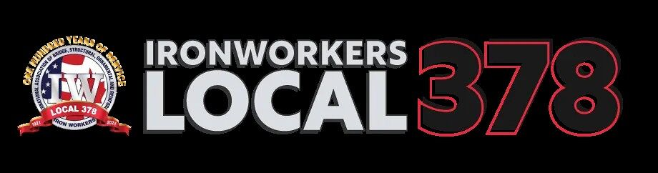
About the Event
DATE

Slide 5
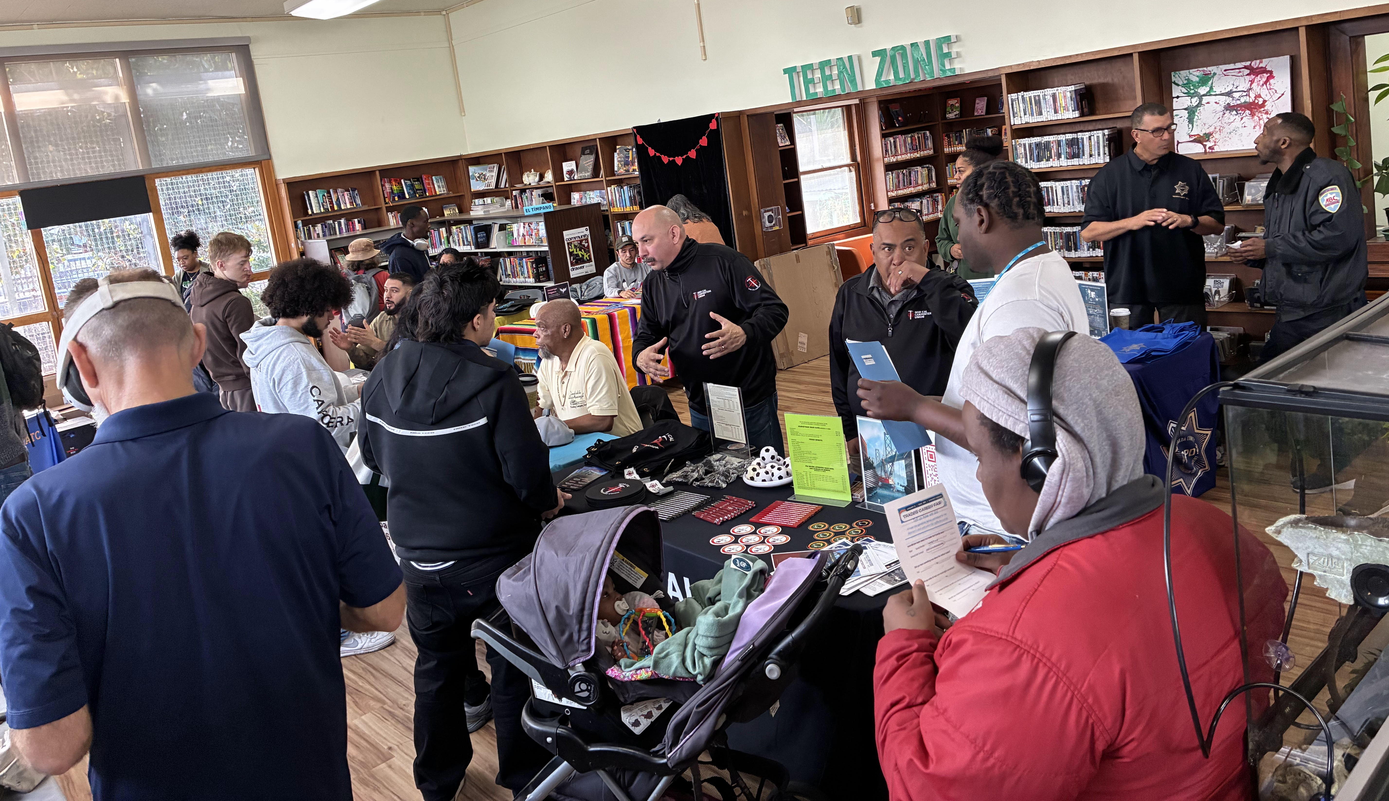
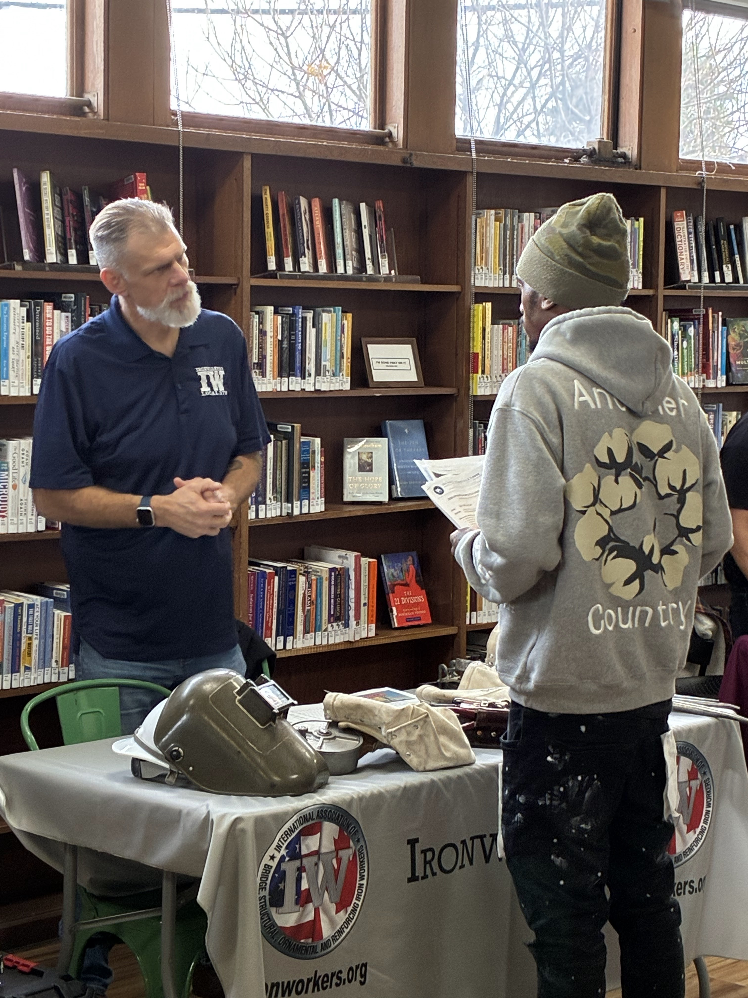
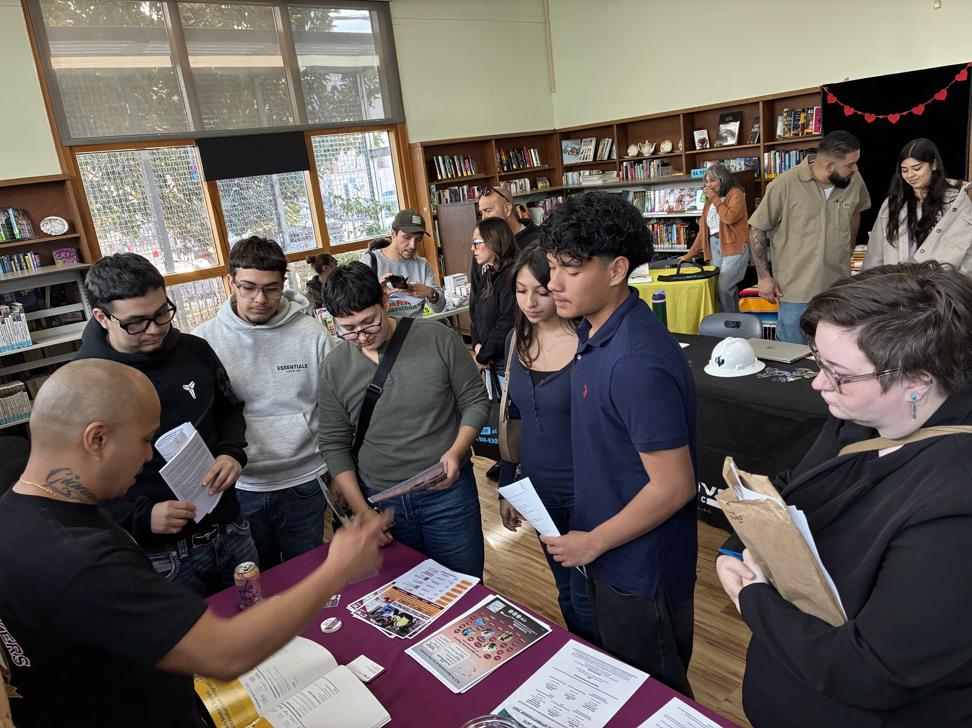
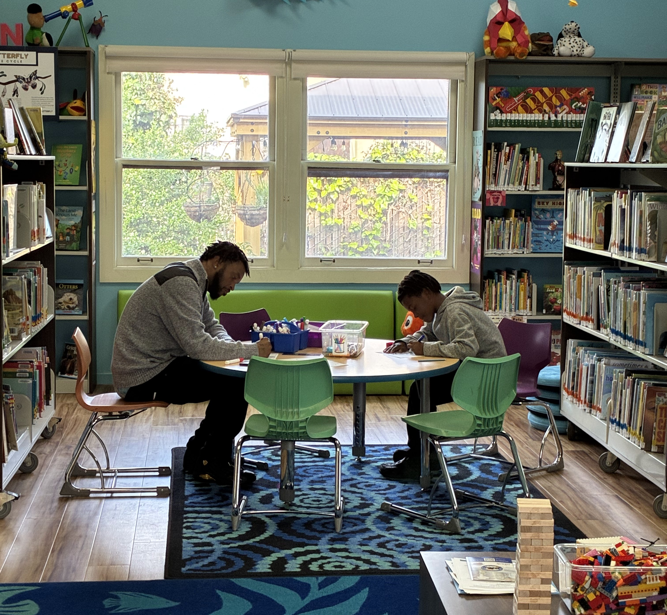
About the Event
Almost 200 participants!

Slide 6


Need and Impact
Demonstrated Need
Useful information
Participants traveled from as far as Dublin and Sacramento
“My husband has been unemployed for 7 months and this is the first fair I felt we got real tangible information we can use! Thank you!”
All feedback surveys:
Learned something new about skilled trades
Make at least one meaningful connection
Recommend this trade fair to others
Notes:
31 feedback surveys

Slide 7
High Return on Investment
Low Budget ($)
More coordination and prep time required
Union & Employer outreach
Facilities management
Logistics

Slide 8


Vision
Establish skilled trades as a meaningful alternative career journey
Establish the local library as a strategic player in building a diverse, skilled, local workforce that will attract employers and encourage local economic growth
Introduce new people to library resources
CONTACT US
Christina.jenq@gmail.com
nbrown@oaklandlibrary.org

