Slide 1

THE
HOT TAKES
SOCIETY
September 28, 2026

Slide 2
GROUP NORMS
01
Debate the idea, not the person
02
One mic at a time
03
Listen to understand
04
Keep it respectful
05
Some topics have boundaries.
06
What happens in The Hot Takes stays in The Hot Takes

Slide 3
HOW TO
1. Hear the Hot Take
2. Pick a Side
3. MOVE!
Today’s debate topic will be announced. Take a minute to think about your opinion.
Choose whether you are FOR or AGAINST the hot take. Sometimes, you may be assigned a side you don’t personally agree with!
Move to the FOR or AGAINST side of the room. Once you choose your side, that becomes your debate team for this round.

Slide 4
HOW TO (continued)
4. Build Your Case
5. Opening Arguments
6. Rebuttal Time
Work with your team to come up with:
Your main argument
2–3 reasons that support it
Examples or evidence
Possible arguments the other side might make
Each side gets a chance to explain its position. Listen carefully because you’ll need to respond!
Respond to the other team’s arguments. Explain why you disagree or point out something they may not have considered.
Try: “I understand your point, but…” or “Another way to look at that is…”

Slide 5
HOW TO (continued)
7. Ask Questions
8. Make Your Closing Argument
9. Vote & Reflect
Each side can ask the other team questions. Good questions help you understand their reasoning or challenge their argument.
Give your strongest reasons one last time. Keep it short, clear, and convincing.
Which side made the strongest case? You can vote for a team even if you personally disagree with their position!

Slide 6
REMEMBER:
A great debater doesn’t just talk. They listen, think, question, and respond.

Slide 7

Should students be allowed to use their phones during the school day?
DEBATE 1:

Slide 8

PICK A SIDE!
You have 2 minutes.
Students should be allowed to use their phones during the school day.
Students should not be allowed to use their phones during the school day.

Slide 9

MOVE!
You have 1 minute.
Move to the FOR or AGAINST side of the room. Once you choose your side, that becomes your debate team for this round.

Slide 10

BUILD YOUR CASE
You have 7 minutes!
Work with your team to come up with:
Your main argument
2–3 reasons that support it
Examples or evidence
Possible arguments the other side might make

Slide 11

OPENING ARGUMENTS
Your group has 3 minutes per side!
Each side gets a chance to explain its position.
Listen carefully because you’ll need to respond!

Slide 12

REBUTTAL TIME!
Your group has 2 minutes per side!
Respond to the other team’s arguments. Explain why you disagree or point out something they may not have considered.
Try: “I understand your point, but…” or “Another way to look at that is…”

Slide 13

ASK QUESTIONS!
You have 4 minutes!
Each side can ask the other team questions.
Good questions help you understand their reasoning or challenge their argument.

Slide 14

MAKE YOUR CLOSING ARGUMENTS!
Your group has 2 minutes per side!
Give your strongest reasons one last time.
Keep it short, clear, and convincing.

Slide 15
VOTE & REFLECT
You have 2 minutes!
Which side made the strongest case?
You can vote for a team even if you personally disagree with their position!

Slide 16

Is a hot dog a sandwich?
DEBATE 2:

Slide 17

PICK A SIDE!
You have 2 minutes.
A hotdog is a sandwich.
A hotdog is not a sandwich.

Slide 18

BUILD YOUR CASE
You have 7 minutes!
Work with your team to come up with:
Your main argument
2–3 reasons that support it
Examples or evidence
Possible arguments the other side might make

Slide 19
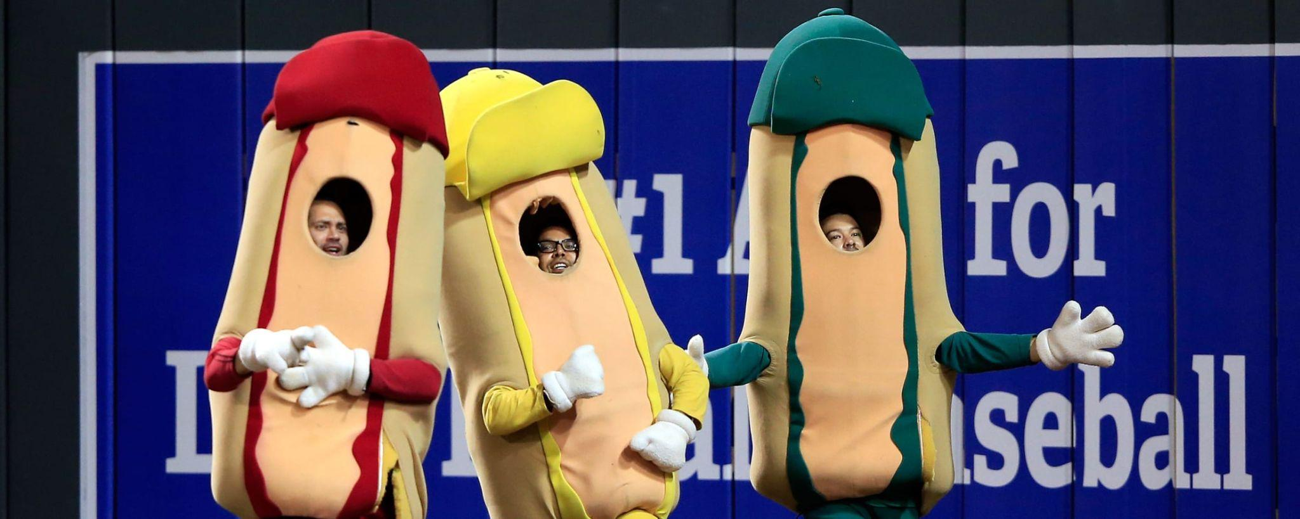
MOVE!
You have 1 minute.
Move to the FOR or AGAINST side of the room. Once you choose your side, that becomes your debate team for this round.

Slide 20
OPENING ARGUMENTS
Your group has 3 minutes per side!
Each side gets a chance to explain its position.
Listen carefully because you’ll need to respond!

Slide 21
REBUTTAL TIME!
Your group has 2 minutes per side!
Respond to the other team’s arguments. Explain why you disagree or point out something they may not have considered.
Try: “I understand your point, but…” or “Another way to look at that is…”

Slide 22
ASK QUESTIONS!
You have 4 minutes!
Each side can ask the other team questions.
Good questions help you understand their reasoning or challenge their argument.

Slide 23
MAKE YOUR CLOSING ARGUMENTS!
Your group has 2 minutes per side!
Give your strongest reasons one last time.
Keep it short, clear, and convincing.

Slide 24
VOTE & REFLECT
You have 2 minutes!
Which side made the strongest case?
You can vote for a team even if you personally disagree with their position!

